Slide 1

Covid Impact on Society
DSTE Group Project
Junling Wang(Msc Data Science), Aojie Yu(Msc Data Science), Alexander Kichutkin (MSc Statistics),
Shanglun Feng (MSc Data Science), Elisabeth Brugger (MSc Spatial Development and Infrastructure Systems)

Slide 2




Table of contents
Introduction
Model construction
Social impact analysis
Conclusion
Background info
Literature review
Data source
SEIR
Prophet
AR
MA
ARIMA
SARIMA
auto-ARIMA
auto-SARIMA
ITSA
Inference
Policy analysis
Zoom usage
Unemployment
Quantitative result
Result to knowledge
Notes:
Other parameters will be estimated by fitting the model with the data.

Slide 3

Introduction

Slide 4




Why a project on the covid pandemic?
Worldwide medico-socio-economic issue of major importance.
Current. Data updates.
Needs constant research.
Decision-makers need support with the best pandemic predictions possible.
The crisis must be managed the best.
The most work on it, the better.
Notes:
Compartmental models are a very general modelling technique. They are often applied to the mathematical modelling of infectious diseases. The population is assigned to compartments with labels – for example, S, I, or R, (Susceptible, Infectious, or Recovered).

Slide 5
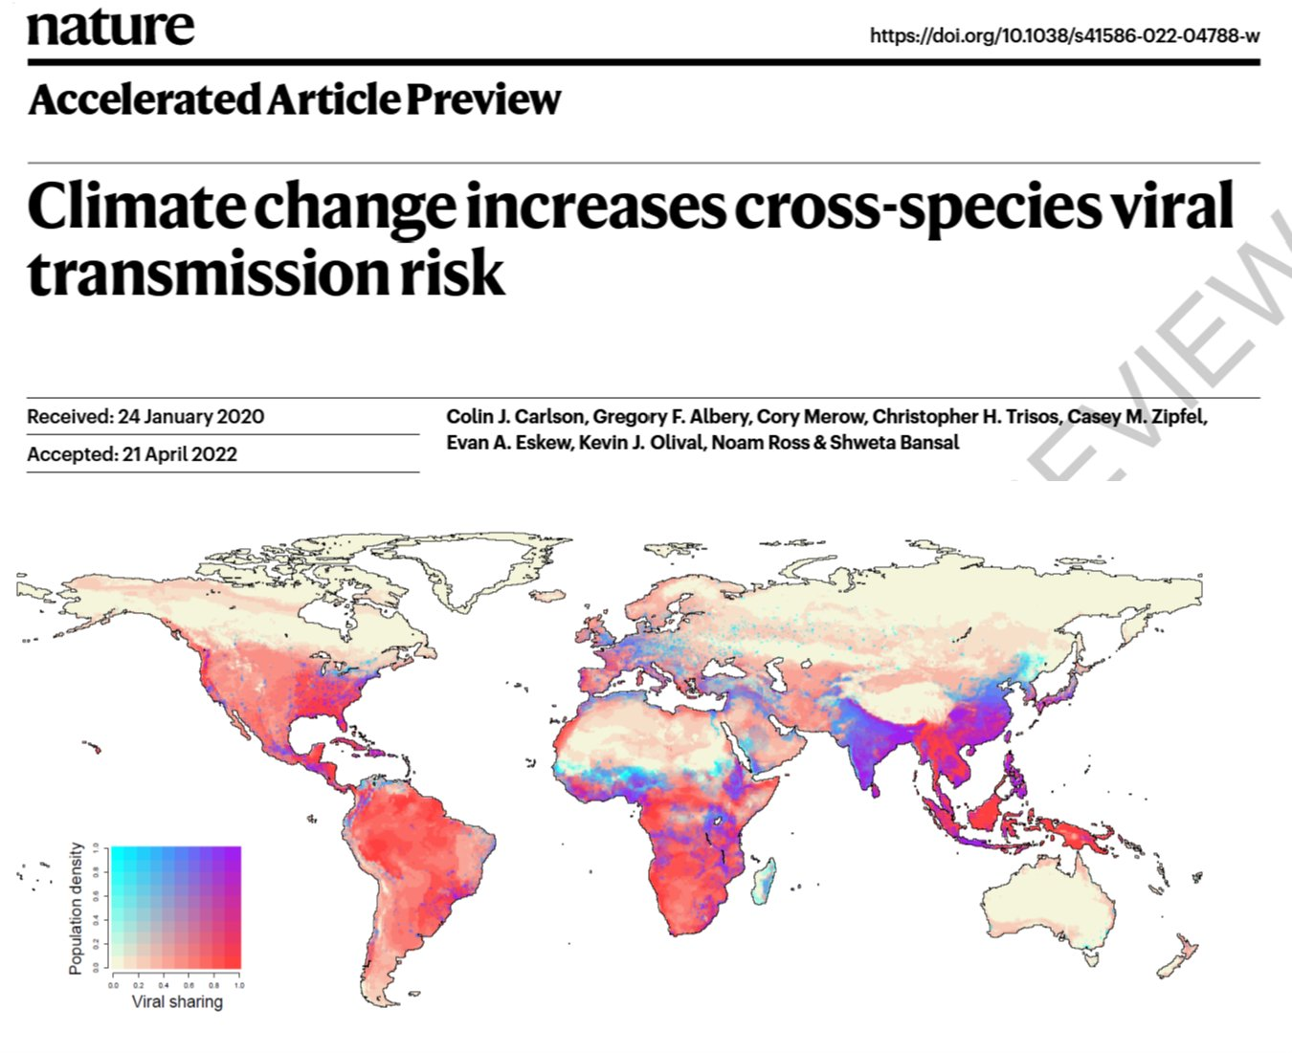



Going further
Increasing risk of future pandemics
(antibiotic resistance, climate change, ...)
→ Important to assess how to:
- predict their development
- assess their influence on society
We want to evaluate methods on
how to accomplish that in order to
be able to react in the future
Notes:
Compartmental models are a very general modelling technique. They are often applied to the mathematical modelling of infectious diseases. The population is assigned to compartments with labels – for example, S, I, or R, (Susceptible, Infectious, or Recovered).

Slide 6



Problem Formulation:
understand human behavior in pandemic circumstances
facilitate fast & reliable decision making
assess how future pandemics can be dampened/analyzed
Pandemic prediction
peak date, case numbers, rebounds
B) Societal impact
economic welfare, working behaviour

Slide 7
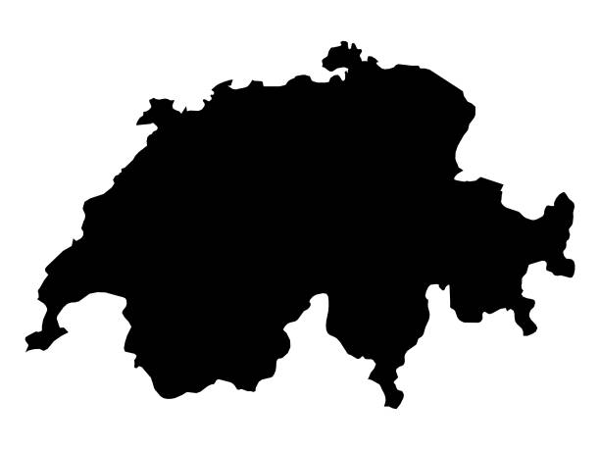

Why we choose this data:
Switzerland
Known system, social behaviors we are used to
Most direct impact on our daily lifes
Can lean on our past experience during swiss lockdown
https://www.istockphoto.com/de/search/2/image?mediatype=illustration&phrase=black+map+of+switzerland
Israel
Similar country size, similar demographics
Although several differences (climate, society, politics)
Comparison: different pandemic measures
Test whether our methods generalize to different countries
with different characteristics
https://www.shutterstock.com/fr/image-vector/black-map-israel-285080450

Slide 8
Annex - Literature review
Paper | Data | Model | Evaluation
P. Wang & cie, Prediction of epidemic trends in COVID-19 with logistic model machine learning technics, Chaos, Solitons and Fractals, Elsevier, 2021. |  | > Logistic model fits the cap of epidemic trend and feeds the cap value into > > FbProphet model based on time series
M. Zivkovic & Cie, COVID-19 cases prediction by using hybrid machine learning and beetle antennae search approach, Sustainable Cities and Society, Elsevier, 2021. |  | > current time-series predictions based on >> machine learning, adaptive neuro-fuzzy inference system >> & nature-inspired algorithms, enhanced beetle antennae search swarm intelligence metaheuristics | > tested and validated against a wider set of benchmark functions and proved that it substantially outperforms original implememntation > evalutated using the WHO official data > compared against several existing state-of-the-art approaches tested on same datasets > test robustness by validate against two different datasets of weekly influenza > proofs of quality with simulation results and comparative analysis
J. C. Clement & Cie, A survey on mathematical, machine learning and deep learning models for COVID-19 transmission and diagnosis, IEEE Reviews in biomedical engeneering, EMB, 2022. |  |  | > mathematical models: compartement models, statistical models > data driven models - ML, DL, natural language processing, SEIR, SIR, sentimental analysis
W.-X. Tang & Cie, Causal Analysis of impact factors of COVID-19 in China, Elsevier 2022. | > Parameters: mobility, group awareness, temperature/weather | > DAG (directed acyclic graph) > regression of toral causal effect among explanatory variables, negative binomial regression > comprehensive causal analysis
F. Rustam & Cie, COVID-19 future forecasting using supervised machine learning models, IEEE Access, 2020. |  | > Future forecasting mechanisms >> LR (Linear regression) >> LASSO ( Least absolute shrinkage and selection operator) >> SVM (support vector machine) >> ES (exponential smoothing) > adjusted R^2 score > supervised ML
S. Khalilpourazari, & Cie, Designing a hybrid reinforcement learning based algorithm with application in prediction on the COVID-1 pandemic in Quebec, Annals of operations research, Springer, 2020. |  | > Novel hybrid reinforcement learning-based algorithm capable of solving complex optimization problems > combined with the most recent mathematical model for Covid-19 pandemic prediction > Reinforcement learning > SIDARTHE > Machine Learning
Z. Yang & Cie, Modified SEIR and AI prediction of COVID-19 in China under public health interventions, Journal of thoracic disease. | > population migration data & epidemiological data | > SEIR (Susceptible-Exposed-Infectious-Removed) > AI
Z.-K. Zhang, Dynamics of information diffusion and its applications on complex networks, Physics reports, Elsevier, 2016. |  | > comparision of methods
Singh R, & Cie, Prediction of the COVID-19 Pandemic for the Top 15 Affected Countries: Advanced Autoregressive Integrated Moving Average (ARIMA) Model, JMIR Public Health Surveill 2020 |  | > ARIMA
Saleh I. Alzahrani, & Cie, Forecasting the spread of the COVID-19 pandemic in Saudi Arabia using ARIMA prediction model under current public health interventions. |  | > ARIMA

Slide 9

SEIR Model Construction
Notes:
Hi,everyone, I am junling wang, I am honored to introduce you about the seir model construction part of our study

Slide 10
Compartmental models in epidemiology
Susceptible
Recovered
People who are healthy but likely or liable to be infected by the infectious disease.
People who recovered from the infectious disease. We assume these people are unlikely infected by disease again.
Infectious
Refers to people who has infected the infectious disease and can infect Susceptible class, turning them into Infectious class.
Notes:
SEIR is a kind of Compartmental models.They are often applied to the mathematical modelling of infectious diseases. The population is assigned to compartments with labels – for example, S, I, or R, (Susceptible, Infectious, or Recovered).

Slide 11
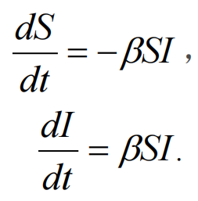
Compartmental models in epidemiology
SI
Notes:
so here we can see the equations of different kinds of compartmental models in epidemiology:
The most basic one is SI model, which only consider the susceptible and infectious groups, so people who are infected cannot recover. some deseases like HIV are suitable for this model. as for the equation: so we can see that derivative of S with respect to time t is equal to negative beta S I, and beta is the rate of infectious.
and then the derivative of I with respect to t is equal to positive beta S I, which is the people who transfer from S group to I group.
then we come to SIS model, here we considered that infectious people can still recovered to susceptible. so the derivative will plus I multiplied by gamma, which is the recover rate.
but we understand that people who already recovered are often immune to this disease, therefore we come to the SIR model: here we have R group which means recovered. so the pipeline will become S to I to R, with beta as infectious rate and gamma as recover rate.
but we also know that bacteria and virus are quite tricky, for many important infections, there is a significant latency period during which individuals have been infected but are not yet infectious themselves. For example covid-19. So we assign these people to compartment Exposed and come to the SEIR model. here the pipeline changes to S to E to I to R. with alpha as the inverse of average latency period,and gamma1 gamma2 are recover rate of group E and group I.
Since we are study covid-19, it's reasonable to use SEIR as our model.

Slide 12
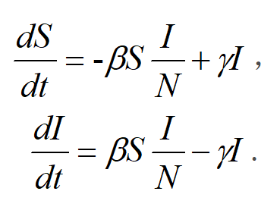
Compartmental models in epidemiology
SI
SIS
Notes:
so here we can see the equations of different kinds of compartmental models in epidemiology:
The most basic one is SI model, which only consider the susceptible and infectious groups, so people who are infected cannot recover. some deseases like HIV are suitable for this model. as for the equation: so we can see that derivative of S with respect to time t is equal to negative beta S I, and beta is the rate of infectious.
and then the derivative of I with respect to t is equal to positive beta S I, which is the people who transfer from S group to I group.
then we come to SIS model, here we considered that infectious people can still recovered to susceptible. so the derivative will plus I multiplied by gamma, which is the recover rate.
but we understand that people who already recovered are often immune to this disease, therefore we come to the SIR model: here we have R group which means recovered. so the pipeline will become S to I to R, with beta as infectious rate and gamma as recover rate.
but we also know that bacteria and virus are quite tricky, for many important infections, there is a significant latency period during which individuals have been infected but are not yet infectious themselves. For example covid-19. So we assign these people to compartment Exposed and come to the SEIR model. here the pipeline changes to S to E to I to R. with alpha as the inverse of average latency period,and gamma1 gamma2 are recover rate of group E and group I.
Since we are study covid-19, it's reasonable to use SEIR as our model.

Slide 13
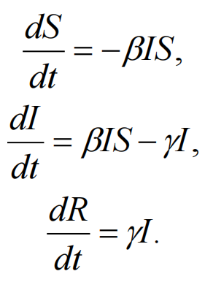
Compartmental models in epidemiology
SI
SIS
SIR
Notes:
so here we can see the equations of different kinds of compartmental models in epidemiology:
The most basic one is SI model, which only consider the susceptible and infectious groups, so people who are infected cannot recover. some deseases like HIV are suitable for this model. as for the equation: so we can see that derivative of S with respect to time t is equal to negative beta S I, and beta is the rate of infectious.
and then the derivative of I with respect to t is equal to positive beta S I, which is the people who transfer from S group to I group.
then we come to SIS model, here we considered that infectious people can still recovered to susceptible. so the derivative will plus I multiplied by gamma, which is the recover rate.
but we understand that people who already recovered are often immune to this disease, therefore we come to the SIR model: here we have R group which means recovered. so the pipeline will become S to I to R, with beta as infectious rate and gamma as recover rate.
but we also know that bacteria and virus are quite tricky, for many important infections, there is a significant latency period during which individuals have been infected but are not yet infectious themselves. For example covid-19. So we assign these people to compartment Exposed and come to the SEIR model. here the pipeline changes to S to E to I to R. with alpha as the inverse of average latency period,and gamma1 gamma2 are recover rate of group E and group I.
Since we are study covid-19, it's reasonable to use SEIR as our model.

Slide 14
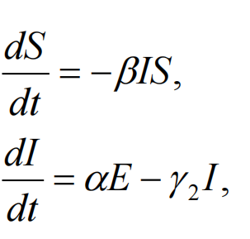
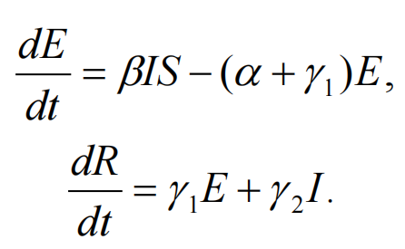
Compartmental models in epidemiology
SI
SIS
SIR
SEIR
Notes:
so here we can see the equations of different kinds of compartmental models in epidemiology:
The most basic one is SI model, which only consider the susceptible and infectious groups, so people who are infected cannot recover. some deseases like HIV are suitable for this model. as for the equation: so we can see that derivative of S with respect to time t is equal to negative beta S I, and beta is the rate of infectious.
and then the derivative of I with respect to t is equal to positive beta S I, which is the people who transfer from S group to I group.
then we come to SIS model, here we considered that infectious people can still recovered to susceptible. so the derivative will plus I multiplied by gamma, which is the recover rate.
but we understand that people who already recovered are often immune to this disease, therefore we come to the SIR model: here we have R group which means recovered. so the pipeline will become S to I to R, with beta as infectious rate and gamma as recover rate.
but we also know that bacteria and virus are quite tricky, for many important infections, there is a significant latency period during which individuals have been infected but are not yet infectious themselves. For example covid-19. So we assign these people to compartment Exposed and come to the SEIR model. here the pipeline changes to S to E to I to R. with alpha as the inverse of average latency period,and gamma1 gamma2 are recover rate of group E and group I.
Since we are study covid-19, it's reasonable to use SEIR as our model.

Slide 15
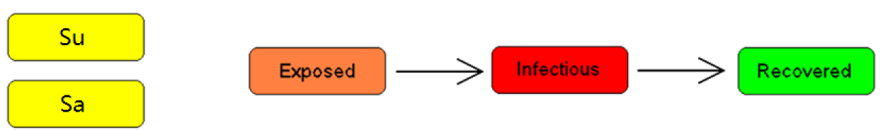
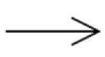
Modified SEIR Model
Notes:
in our study, we make slight modification for seir. we separate susceptible people into separate groups: Su and Sa. Su is people who don't protect themself in a proper way, Sa represent people who protect themself in a proper way. in this way, we will have beta1 to beta 4 represent different transmission probability. others stay the same.
E: Individuals who have been exposed to the virus but have not started spreading infection.
Su: Susceptible people who don't protect themself in a proper way
Sa: Susceptible people who protect themself in a proper way
I: Infectious
R: Recovered
β1：Parameter that measure the probability of transmission from Su TO E
β2：Parameter that measure the probability of transmission from Su TO I
β3：Parameter that measure the probability of transmission from Sa TO E
β4：Parameter that measure the probability of transmission from Sa TO I
α：Parameter that measure the probability of transmission from E to I
γ：Parameter that measure the probability of transmission from I to R

Slide 16
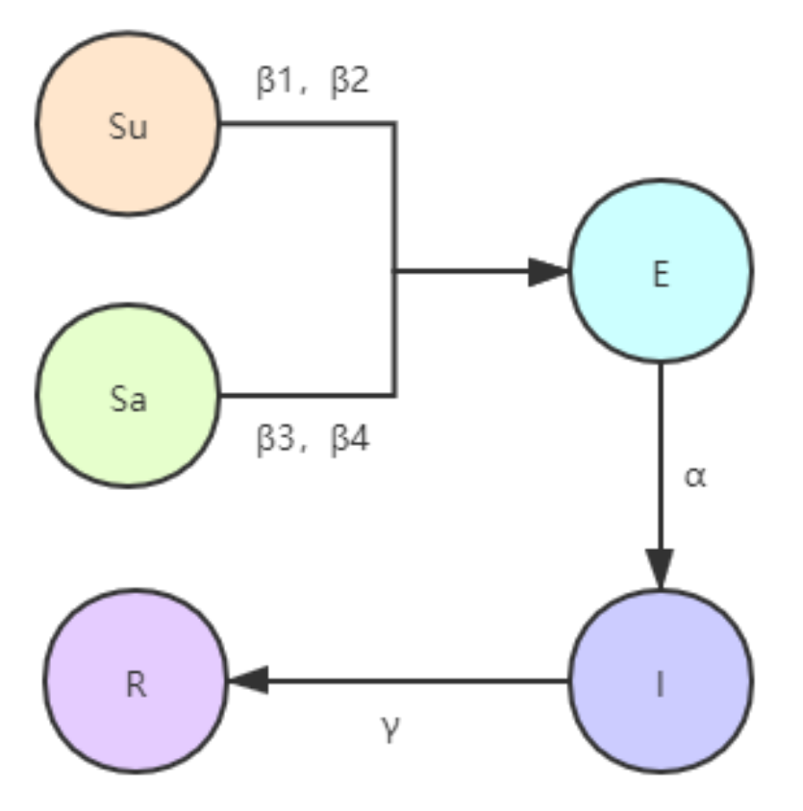
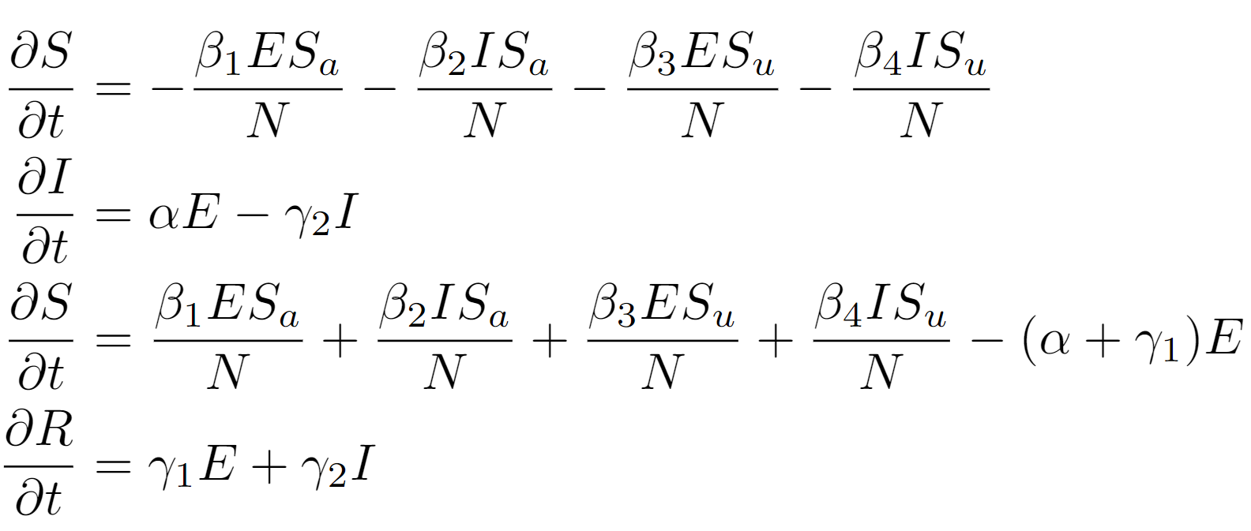
Modified SEIR Model
Notes:
The modified model equation is shown here.
so its a bit more complex than the original SEIR model, but we can see its just because we separate S into Su and Sa, therefore all formula will consider different transimission rate. especially beta1 to beta4. but in principle its just SEIR.
Gamma1-gamma4 is ratio!!!

Slide 17
Parameters Setting
Alpha
Beta
Active Case
Real Infected Cases
Parameter that measure the probability of transmission from E to I. According to the [Yang2020], alpha in general should be 0.78735.
Parameter that measure the probability of transmission from E to Su\Sa or from I to Su\Sa. According to the [Yang2020], (β1+β3)/2= (β2+β4)/2=0.15747
John Hopkins covid data source do not provide data for active cases since 2021 Aug. According to [CDC2022][Catherine2022], we classified patients who were infected for 1 to 5 days as active.
According to [Irons2021], the real infected cases should be much more than reported cases, and the ratio should be 1.66.
Notes:
here is the parameter setting in our model.
the first is alpha, which represent the probability of transimission from E to I, according to yang2020, alpha should be 0.787.
we also refer to yang2020 for beta, since we separate beta into beta1 to beta4, we have the equation that average of beta1 and beta3 should equal to the average of beta2 and beta4 and equal to 0.157.
The active cases refer to Infectious group. since john hopkins data source do not provide this kind of data since2021 aug, we refer to 2 report which classified patients who were infected for 1 to 5 days as active. there are still different estimatation for this period, this place should have more future work to do.
finally, we consider the real infected cases which should be much more than the reported cases according to irons2021. the ratio of real infected cases compare to reported cases should be around 1.66
Other parameters will be estimated by fitting the model with the data.

Slide 18
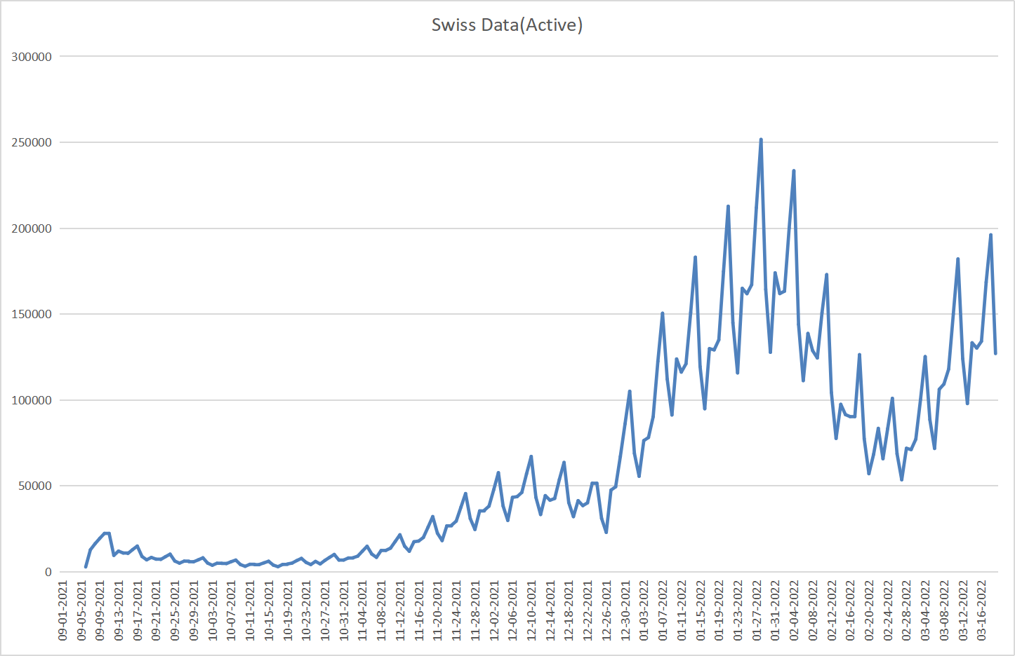
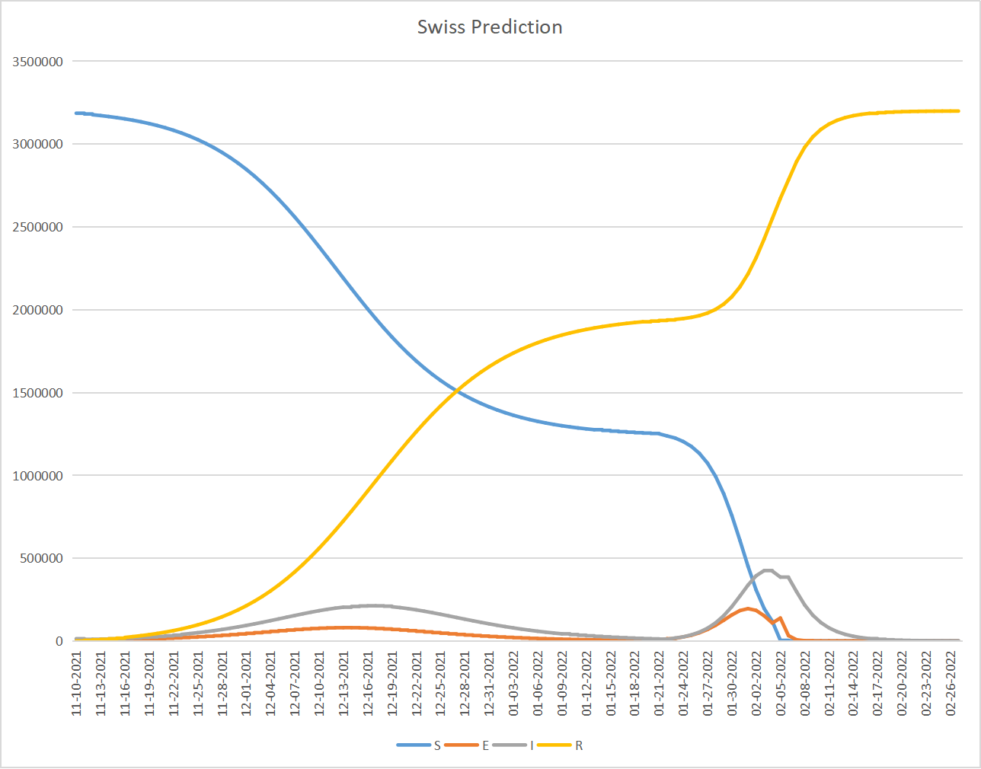
Swiss Model
Data Range: 09-01-2021 to 03-19-2022
Peak: 01-28-2022
Peak case number: 251,665
Rebound point: 02-27-2022
Data Range: 11-10-2021 to 02-26-2022
Peak: 02-03-2022
Peak case number: 425,151(ratio=1.689,close to 1.66)
Rebound point: No Rebound (pandemic ends at
02-26-2022)
Notes:
We present the active cases graph on the left which corresponds to infectious group.
On the right is the SEIR model prediction, the blue line represent susceptible, orange represent exposed, grey is infectious, yellow is recovered
The data range in the left hand side is September 1st 2021 to march 19th,2022,which represent one wave of covid-19 spread.
We set the starting point as November 10th according to the real data and generate the prediction result.
The peak in the left hand side is January 28th 2022, and the predicted peak is February 3rd 2022, which is very similar.
The peak case number in real data is 2handred and fifty thousands, the predicted value is around 4hundred twenty five thousands, and the ratio is 1.689 which is fairly close to 1.66.
However, we find a rebound trend in real data at February 27th 2022, which cannot reflected in our model. Which may due to social effect.

Slide 19
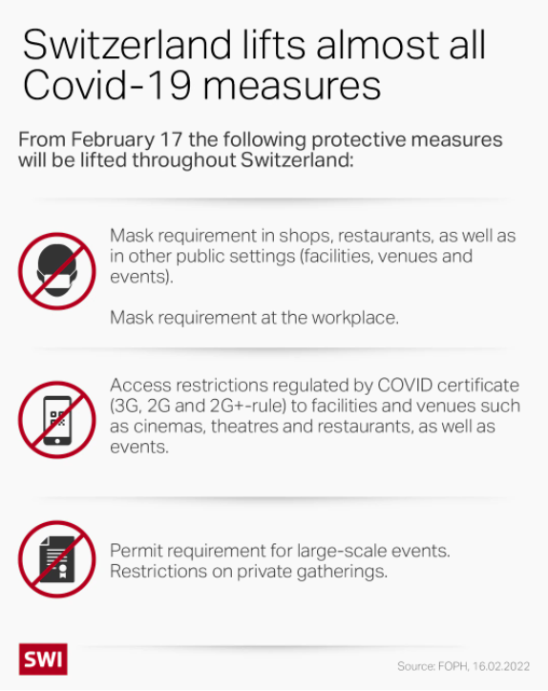
Rebound explanation
Notes:
We notice that swiss have lifts a lot of restrictions from February 17, including mask requirement in shops, access restrictions regulated by certificate and restrictions on private gatherings. This policy is likely to cause the active case of covid-19 to rebound.

Slide 20
Parameter estimation
Parameters | Value
Susceptible ratio | 0.4 (similar to 0.5 as stated in[Jiang2020])
β1 | 0.016
β2 | 0.016
β3 | 0.3
β4 | 0.3
Recover Rate | 0.289 (similar to 0.3 as stated in[Jiang2020])
Contact1 | 20.23
Contact2 | 39
Notes:
The estimated parameters are listed as above, here we find the susceptible ratio among whole country is around 0.4, which is similar to 0.5 as stated in Li2020.
We find beta1 and 2 should be dramatically lower than beta3 and 4 ,which means people who well protect themselves have dramatically lower infectious rate than people who do not take care of the pandemic.
The recover rate estimated is around 0.3 which is also similar to li2020.
We also find that there is an upward trend in the average number of contacts per person, since the initial contact number is 20.23, and in the end, the contact number increase to 39, as estimated by our model.

Slide 21
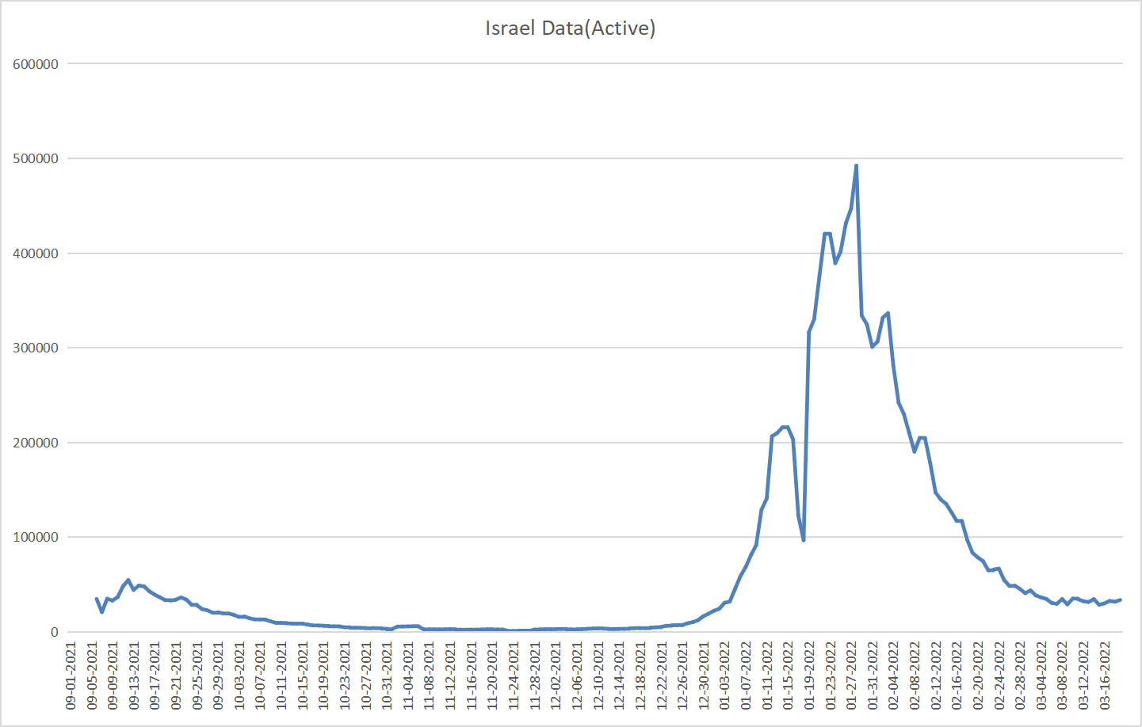
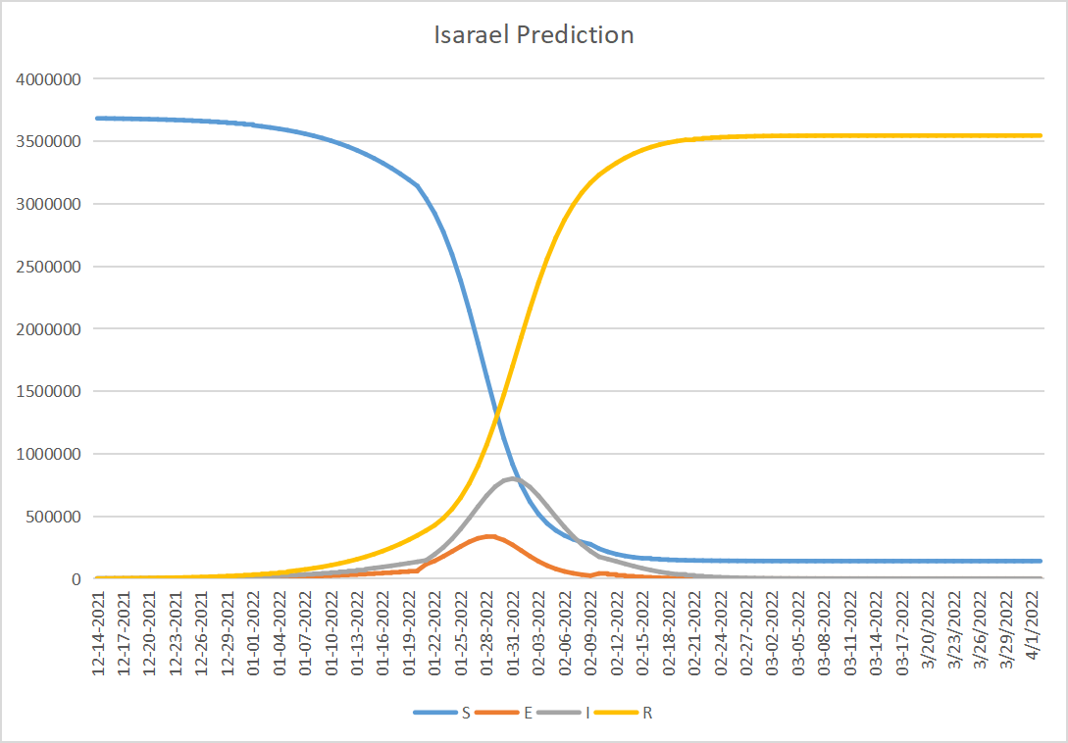
Israel Model
Data Range: 09-01-2021 to 03-19-2022
Peak: 01-28-2022
Peak case number: 492,301
Rebound point: No Rebound
Data Range: 12-14-2021 to 04-02-2022
Peak: 01-31-2022
Peak case number: 800,607(ratio=1.626,close to 1.66)
Rebound point: No Rebound
Notes:
To test our parameter in a general way, we also do prediction based on Israel data. Israel have similar amount of population compares with swiss, which make it a good control sample.
Similar to swiss model, we present the active cases graph on the left which corresponds to infectious group.
On the right is the SEIR model prediction.
The data range in the left hand side is September 1st 2021 to march 19th,2022,which represent one wave of covid-19 spread.
We set the starting point as December 14th according to the real data and generate the prediction result.
The peak in the left hand side is January 28th 2022, and the predicted peak is January 31st 2022, which is very close.
The peak case number in real data is 4handred and ninety thousands, the predicted value is around 8hundred thousands, and the ratio is 1.626 which is fairly close to 1.66.
There is no rebound in both the real data and the prediction, we can see the trend was predicted in a fairly good way.

Slide 22
Findings through model
Parameters | Value
Susceptible ratio | 0.4 (similar to 0.5 as stated in[Jiang2020])
β1 | 0.016
β1 | 0.016
β1 | 0.3
β1 | 0.3
Recover Rate | 0.289 (similar to 0.3 as stated in[Jiang2020])
Contact1 | 20.23
Contact2 | 10.23
Notes:
The estimated parameters are listed as above, here all parameters are remain the same as the swiss model except contact number, which means our parameters may have the potential of applying to general cases.
The estimated contact2 parameter here is 10.23, which is lower than contact1, which means there is a downward trend in the average number of contacts per person in Israel.

Slide 23
SEIR Conclusion
Prediction
Parameter: Contact2
Both Swiss and Israel models predict the peak date and peak case number in a roughly accurate way.
Both models have similar parameters except contact2
Other Parameters
Limitation
The parameters obtained or validated by our model can provide reference for subsequent research.
Swiss model fails to predict rebound point, which may be due to Swiss policy of releasing restriction of quarantine or the limitations of SEIR model.
Notes:
From what has been discussed above, we may come to the conclusion that:
1. Both swiss and Israel model predict the peak date and peak case number in a roughly accurate way.
2. As for the parameter contact2: Both model have similar parameters except contact2, which indicate that Israel successfully restrict patients to contact with other people.
3. For other parameters, we validate it with 2 countries’ data, it may provide reference for subsequent research.
4. For limitations of our model: we can see that Swiss model fail to predict rebound point, which may due to swiss policy of releasing restriction of quarantine or the limitations of SEIR model.

Slide 24

Forecast with Machine Learning-Model and Statistical Model

Slide 25
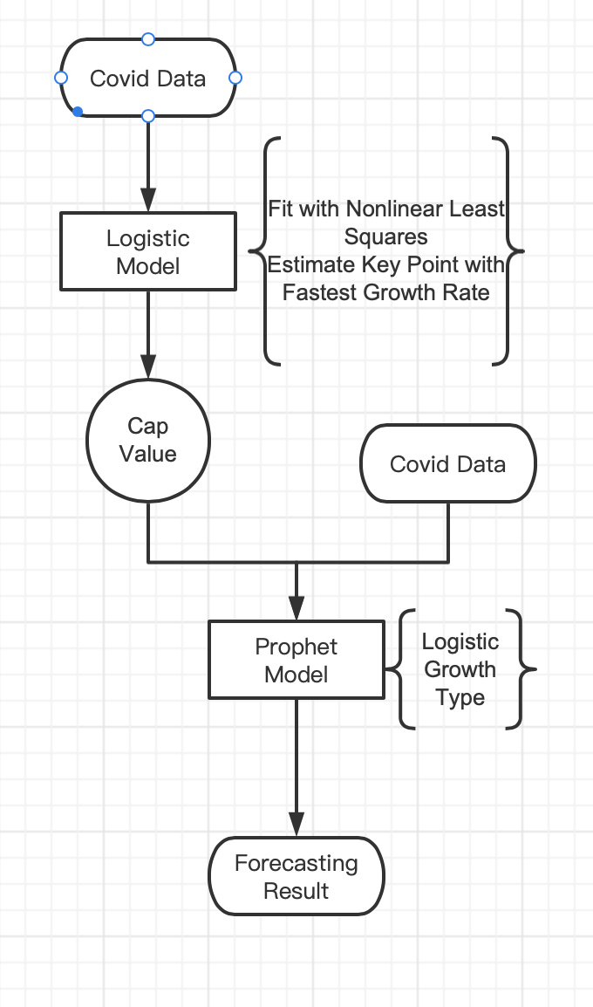
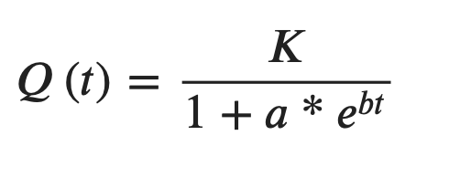
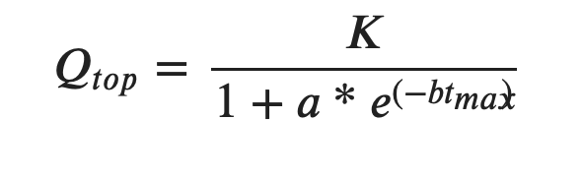
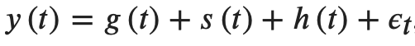
Logistic growth model + FbProphet model
Logistic growth：
Facebook Prophet: time series forecasting based on additive model
Notes:
Prophet is an open source framework of Facebook for time series forecasting based on additive model which is opened up to the public in 2017 [13], [22]. The non-linear trends of Prophet are fitted with yearly, weekly, and daily seasonality, plus holiday effects
Prophet allows you to make forecasts using a logistic growth trend model, with a specified carrying capacity.
where g(t) is a trend function used to analyze the non-periodic changes of time series. s(t) a periodic term, reflecting the periodic change, such as the periodicity of a week or a year. h(t) is the influence of an occasional day or days, such as a holiday. ϵt is an error term, on behalf of the failed to consider the effect of the error of the model. Here in our research, we only consider about the non-periodic changes of time series.

Slide 26
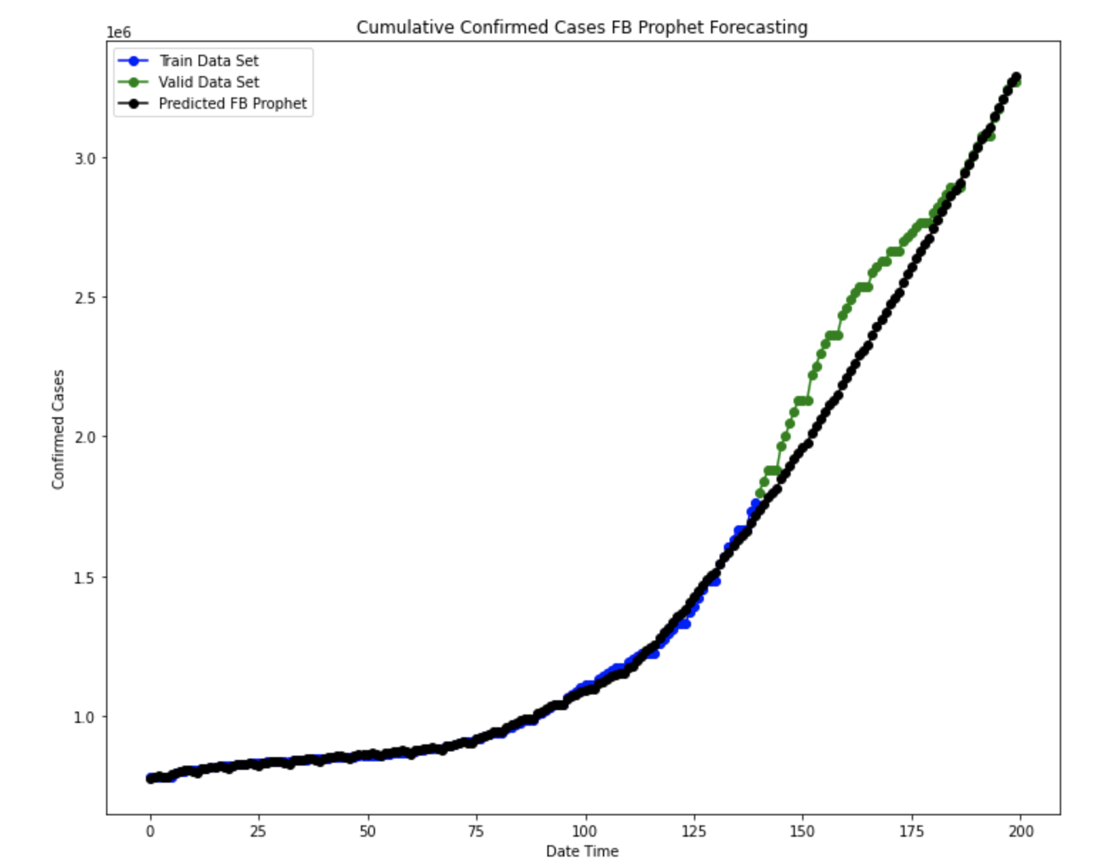


Models performance measures
-Pro&Con:
Epidemic size &trend &future turning point
Small peak
-Further research:
Piecewise prediction with a variant of logistic model
Converting the control measures, like travel bans as holiday effects into Prophet model
Root Mean Square Error for FB Prophet Model: 149132.02422274736 (over the following 60 days)

Slide 27
Linear parametric model
-Models description
- Autoregressive AR(p)
- Moving Average MA(q)
- Non-seasonal Autoregressive Integrated Moving Average ARIMA(p,d,q)
- Seasonal Autoregressive Integrated Moving Average SARIMA(p,d,q)(P,D,Q)m
involve backshifts of the seasonal period
Notes:
//SARIMA(p,d,q)(P,D,Q)m
// lowercase Non-seasonal part uppercase Seasonal part of
of the model of the model
// m= number of observations per year
//The seasonal part of the model consists of terms that are similar to the non-seasonal components of the model, but involve backshifts of the seasonal period.
//m=12 monthly data
///In an autoregression model, we forecast the variable of interest using a linear combination of past values of the variable. (
using past values of the forecast variable in a regression,
The term autoregression indicates that it is a regression of the variable against itself.
E_t white noise
lagged values of y_t
c constant
like a muultiple regression with lagged values of y_t as predictor
AR(p)
//a moving average model uses past forecast errors in a regression-like model.
MA(q)
// combine differencing with autoregression and a moving average model, we obtain a non-seasonal ARIMA model.
y't is the differenced series
The “predictors” on the right hand side include both lagged values of y_t and lagged errors
ARIMA(p,d,q)
p
=
order of the autoregressive part;
d
=
degree of first differencing involved;
q
=
order of the moving average part.
Forecast for y at time t = constant
+ weighted sum of the last p values of y
+ weighted sum of the last q forecast errors
MA is the present value of a series, which is defined as a linear combination of past errors
\\The SARIMA extension of ARIMA that explicitly models the seasonal element in univariate data.

Slide 28
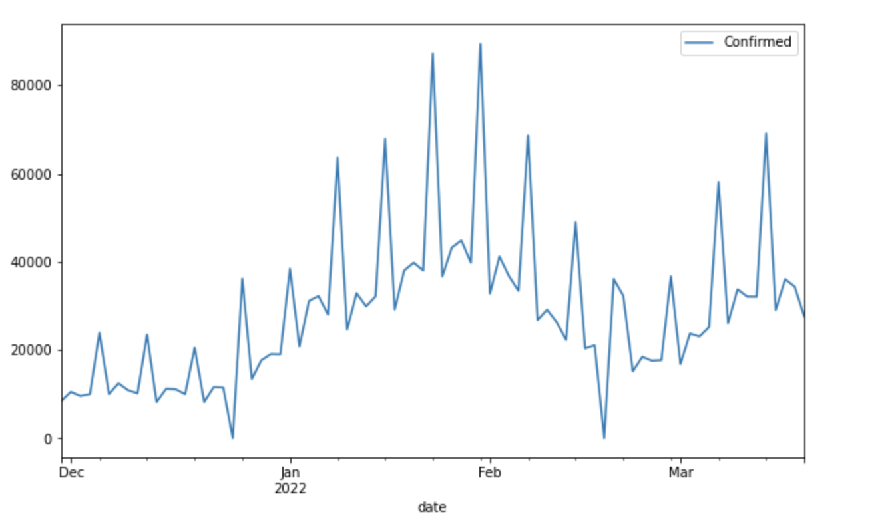
Data description
-John Hopkins Coronavirus resource center
-Nov 29th 2021,first suspected case of omicron
variant of COVID-19 detected in Switzerland
Notes:
The data used in this work refer the daily and cumulative number of confirmed COVID-19 cases in Saudi Arabia, and are collected from the official website of Saudi Ministry of Health (https://covid19.moh.gov.sa). They contain information about the daily and cumulative number of infected cases in Saudi Arabia from March 2, 2020 to April 20, 2020.
data from COVID-19 Data Repository by the Center for Systems Science and Engineering (CSSE) at Johns Hopkins University (https://github.com/CSSEGISandData/COVID-19). It provides cleaned time series data (one case report per day) for covid-19 confirmed, covered, and deaths in Switzerland since Feb 14, 2020, till now. The data is relatively reliable since it is scrapped from the Switzerland Federal Office of Public Health FOPH(https://www.covid19.admin.ch/en/overview).

Slide 29
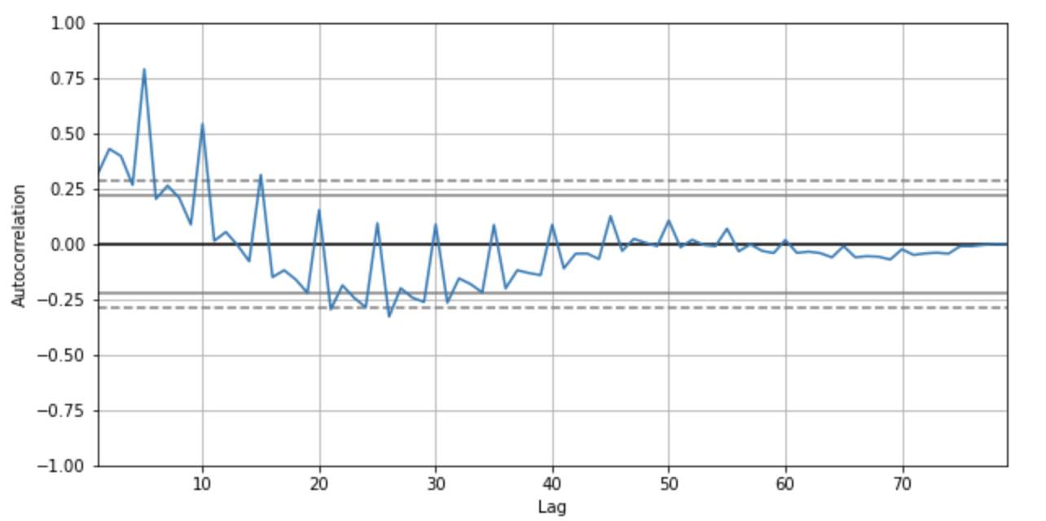
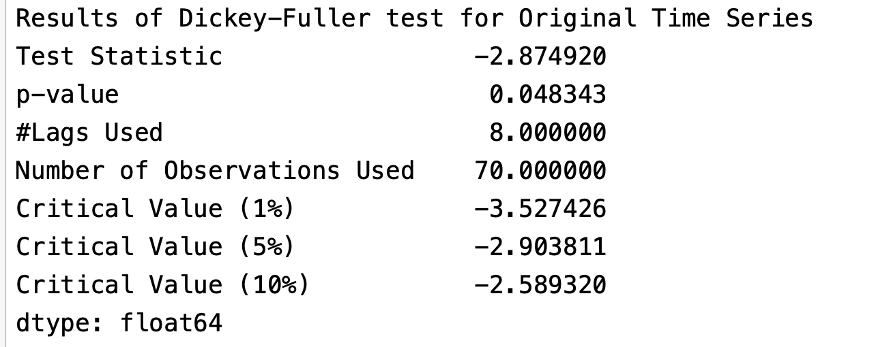
Stationarity evaluation
-Autocorrelation plot
-Augmented Dickey–Fuller (ADF) test
H0:the time series is non-stationary
Notes:
autocorrelation plot tells
stationary &not random, no apparent seasonality
AR: Alternating positive and negative, decaying to zero
AR, ARMA , good fit
MA not
decay to zero , Series is stationary.
the p-value obtained was less than the significance level (p < 0.05) and the statistical ADF is lower than the critical values at 10% ,so null hypothesis was rejected., no transformation on the original dataset is necessary

Slide 30
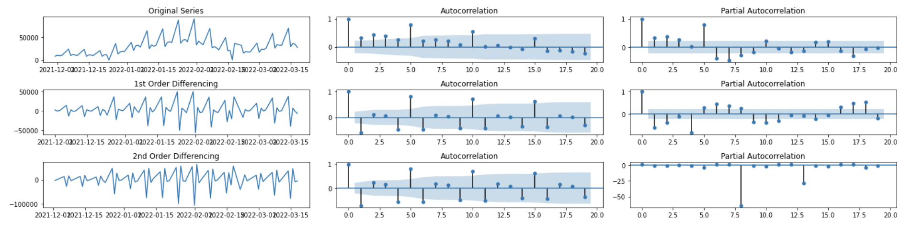
Parameters selection - manual
-ACF (autocorrelation function)
-PACF (partial autocoorelation function)
Notes:
The order p and q can be determined using the sample autocorrelation function (ACF), partial autocorrelation function (PACF),

Slide 31
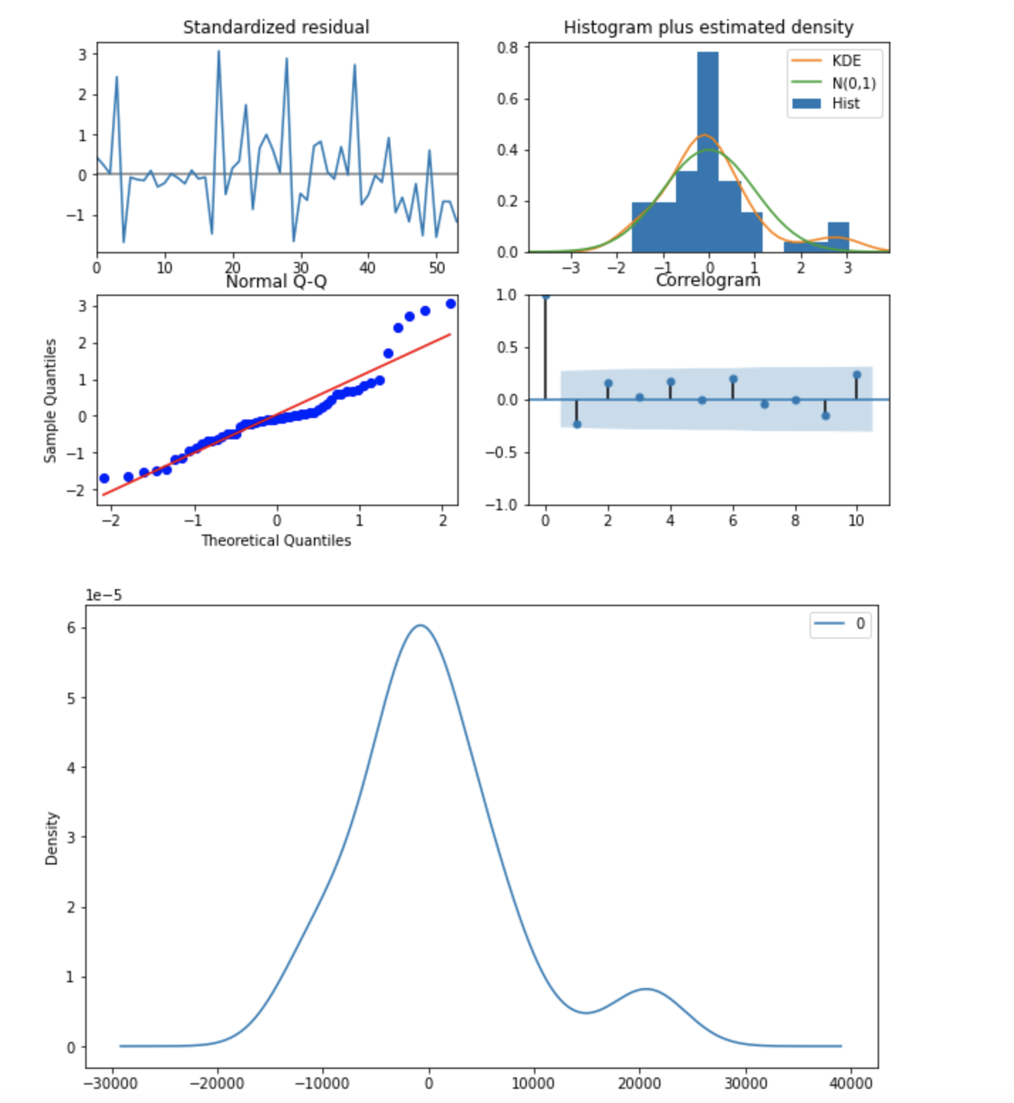
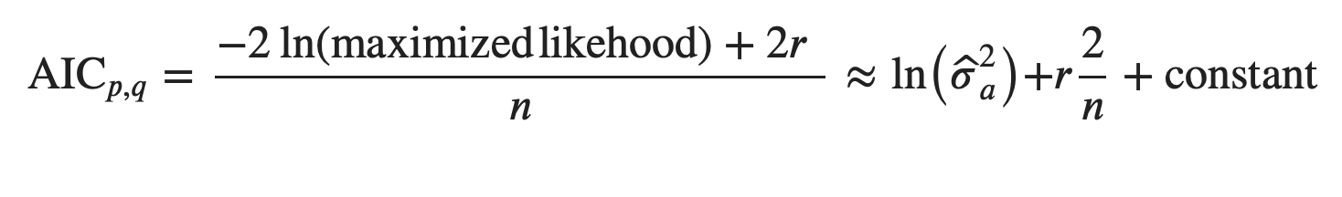
Parameters estimation - automated
-Auto-arima:lowest AIC
-Uncorrelated & normally distributed residuals
Notes:
ARIMA order selection based on AIC approach.
The parameters of ARIMA model were chosen based on the value of Akaike information criterion (AIC) which is given by (7)
where n is the number of data observations, 𝑟=𝑝+𝑞+1 and 𝜎ˆ2𝑎 is the maximum likelihood prediction.
the residuals of our model are uncorrelated and normally distributed with slightly less than zero-mean. I
The normal distribution is symmetric, so it has no skew (the mean is equal to the median).a llittle bit skewed to the right
On a Q-Q plot normally distributed data appears as roughly a straight line

Slide 32
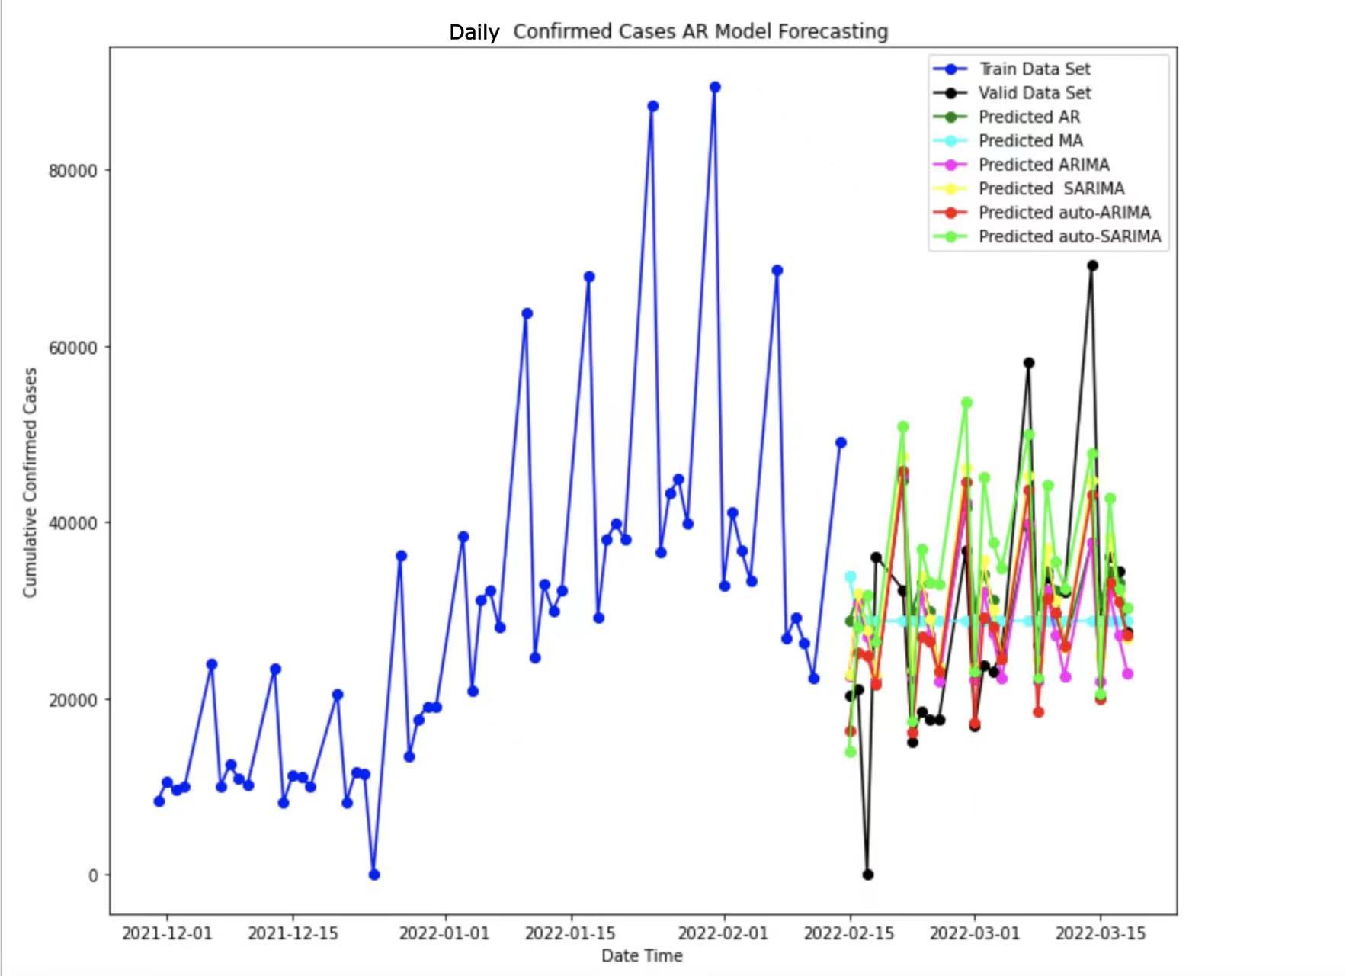
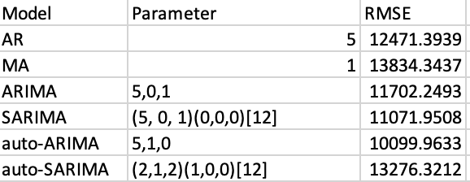
Models performance measures-daily confirmed cases

Slide 33
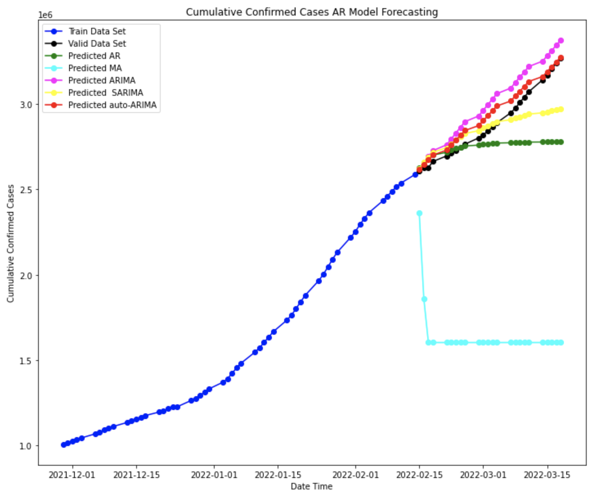
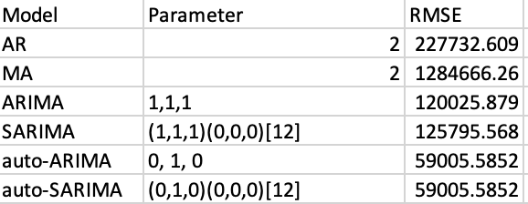
Models performance measures-cumulative confirmed cases
Auto-ARIMA predict trend pattern relatively well
ARIMA-based models are mainly suitable for linear time-series analysis
Possess nonlinear characteristics ->hybrid models (ex:EMD+ARIMA+SVR)
Notes:
tansform: dftest = adfuller((log_series.diff().diff()).dropna(), autolag='AIC')

Slide 34

Social Analysis

Slide 35
Basic Analysis Framework
How to distinguish opinions about COVID-19 data?
$y$social indicator
$X$data about COVID-19 trend data, such as new cases, death, vaccinations , related policy
type | explanation | method
attribute variable | What really matters: Begin of change & how long it lasts. | Interrupted time series analysis
numeric variable | Strength of Covid-19 indeed matters | Granger causality, transfer entropy
Notes:
To study the impact of the COVID epidemic on society, we have to distinguish two opinions about COVID data.
First, we regard COVID as an intervention or event. That is to say, we don’t really care about the new cases, the death every day. What really matters for us is when the intervention have an effect on target social indicator. In this scenario， we use interrupted time series method.
Second, we really care about the new cases, death, vaccination each day. They are more like independent variables and have a direct impact on social indicator.

Slide 36
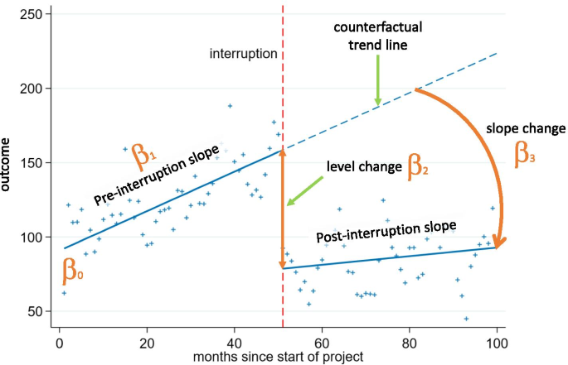
Interrupted Time Series
Interrupted time series analysis (quasi-experimental time series analysis):
Method of statistical analysis involving tracking a long-term period before and after a point of intervention to assess its effects.[1]
[2]
[1] WIKIPEDIA : Interrupted time series
[2] Comparison of six statistical methods for interrupted time series studies: empirical evaluation of 190 published series
Notes:
Interrupted time series analysis doesn’t have much more things than ordinary time series analysis.
It’s used to analyze long-term trend change for a time analysis.
Notice the point of intervention is emphasized in the definition.
interrupted time series analysis is always used in policy research, such as health intervention. Just like the questions we‘re interested in here.
ITSA is considered one of the best designs for establishing causality when RCT are feasible.

Slide 37
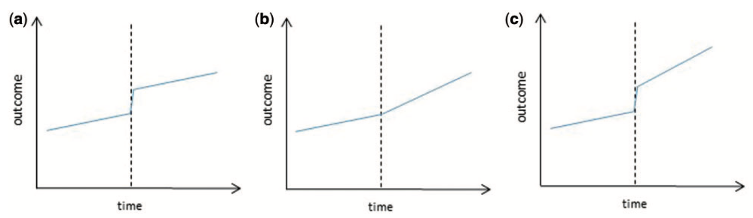
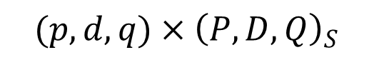
ITSA model
segment regression
type of impact
ARIMA
seasonality
autocorrelation
step change
ramp
time & delay of intervention
$$(p,d,q)×{\left(P,D,Q\right)}_{S}$$
[1]
intervention assumption: The intervention does not need to be introduced overnight but the period of implementation should be well defined.
[1] Interrupted time series regression for the evaluation of public health interventions: a tutorial
Notes:
In our discussion, we only use the basic tools for interrupted time series analysis. We use 2 components: segment regression & ARIMA.
segment regression reflects the long-term trends.It needs to define type of impact and the exact intervention time.
For the type of impact, the two most commonly used are step change and ramp, as shown here. The first one is the step, add a level forever. The second one is the ramp, change the slope.
The third one has both a ramp and a step change.
The delay of intervention, as an external parameter, is critical in ITSA. We prefer short-term outcomes expected to change either relatively quickly after an intervention or after a clearly defined lag.
The ARIMA component is just the ordinary ARIMA. It is used to solve problems for seasonality and auto-correlation.
We have to mention that seasonality indeed causes problems in unbalanced short time series.

Slide 38
ITSA issues
 | Problems | Consequences
⭐️Date Event | poorly defined events or incorrect dates | have to cosider a wider range of possible models ITSA model-building process is more exploratory than confirmatory.
Choose Indicator | the available data do not represent a properly random sample of all available data | we get reliable numerical results, but it is not what we really want for realistic meaning
Exclude Rival Explanation | measurement methods change confounders by other interventions that occurred concurrently | wrong conclusion due to other factors, failure analysis
[1]
solution : independent data source & existing researches !!!
[1] Using intervention time series analyses to assess the effects of imperfectly identifiable natural events: a general method and example
Notes:
Here, we list the central issues for ITSA that we should care about.
First, it is about the date event. Many researchers recommend against the use of ITSA in not clearly defined occurence of the event. If the date event is problematic, we will have problems while modeling.
Second, choose indicator. Our indicator may not really represent the conclusion we want to get. For example, the google trend in China can hardly reveal anything. Because Google is not available in China,
Third, the rival explanation. Society is a complex system. Every phenomenon can have many explanations. We can not get correct conclusion if we ignore some important factors.
So what should we solve these problems? The only principle is to refer to independent data source, information source and existing researches. That is to say, we cannot determine the event date just by our eyes and our models to avoid overfittiing.

Slide 39
ITSA practice
Data | Date Event | choose indicator | Exclude Rival Explanation
Google Trend: Zoom⭐️ | easy, SAH policy come into force at once | hard, the gap between search & usage | easy, as personal experiences imply
OECD Data: unemployment | hard, unmeasurable delay | easy, authortative of OECD | hard, unresolved confounders for complex economic system
Notes:
In our project, we work on the two dataset. We mainly deal with zoom data on Google Trend and take unemployment data on OECD as appendix.
The two datasets are selected becase they are complementary in issues of ITSA.
For zoom data, it’s easy to date event and exclude rival explanation because there is nearly no lag at all. But choosing indicator is not difficult, because there is gap between search & usage.
For unemployment data, it’s easy to choose the indicator, because OECD is very authortative. But it is very difficult to date event and exclude rival explanation. Because the economic mechanism is very complicated.

Slide 40
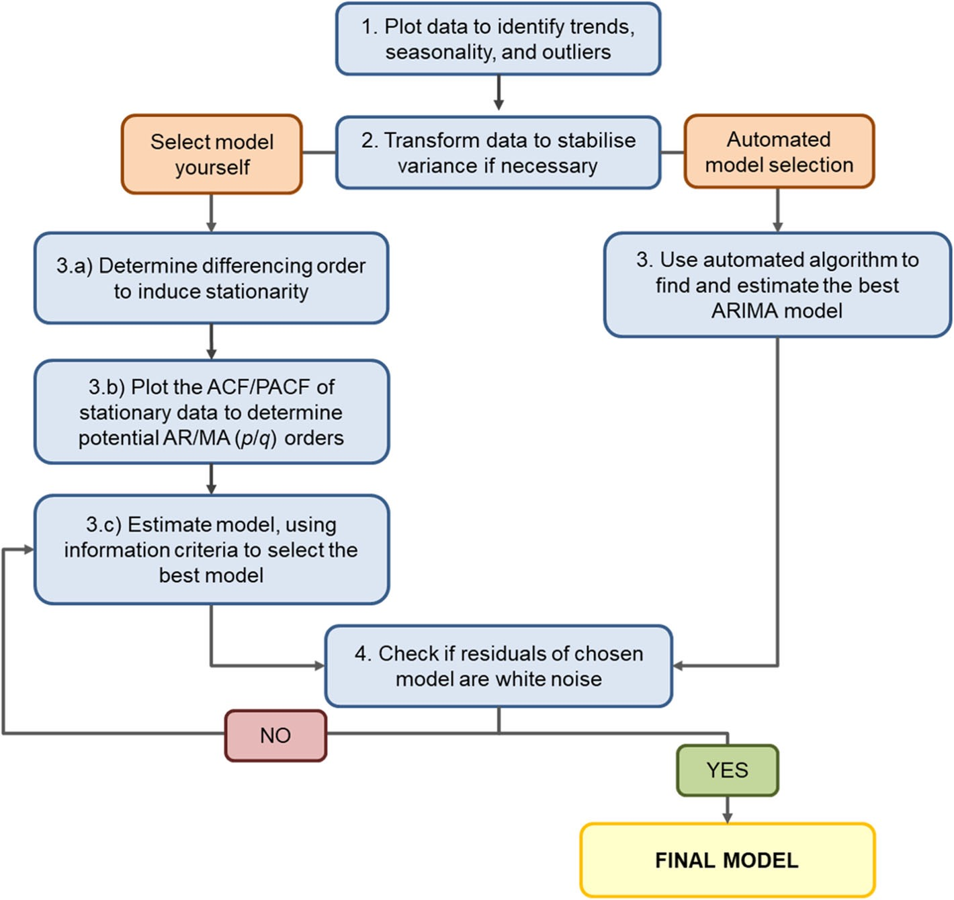
ITSA ARIMA & pipeline
ARMA requirement : stationary
constant mean
constant variance
constant covariance
ARIMA assumption : normally distributed error
[1]
[1] Interrupted time series analysis using autoregressive integrated moving average (ARIMA) models: a guide for evaluating large-scale health interventions
Notes:
In our analysis process, we follow the pipeline here.
First, ## READ
Second, ## READ
Third, ## estimarte model, using information criteria to select the best model.
Fourth, ## READ.
Notice, due to our segmented linear regression component, the procedure of differencing is omitted.

Slide 41
ITSA Zoom problem formulation
Data Selection
start date : 09.04.2017
google trend collection systems change, 2016
zoom release, 2011
event date : 16.03.2020
[1]
delay : no delay
personal experience
end date : before 2022
[2,3,4]
granularity : by week
happen in the middle of March
location : Switzerland
consistent policy
COVID-19
SAH policy
Zoom utilization
Question : How does the SAH policy influence on the ultilize of Zoom, which represent people' change in work-coordinate way?
Is it appropriate to use ITSA?
clear event date
policy researches
What is shape of impact here?
step : immediately effective policy with impact on long-term habits
ramp : demand for search drops to reasonable value
[1] https://www.swissinfo.ch/eng/coronavirus_did-the-swiss-stay--at-home-during-the-coronavirus-lockdown-/45722614
[2] https://www.swissinfo.ch/eng/swiss-anti-covid-curbs-to-remain-at-least-until-end-of-february/47274772
[3] https://www.swissinfo.ch/eng/covid-19_coronavirus--the-situation-in-switzerland/45592192
[4] https://www.swissinfo.ch/eng/switzerland-lifts-most-covid-19-restrictions/47352480
Notes:
In this page, we formulate our problem and explain how we deal with the issues.
The causal graph is our assumption of COVID’s impact on zoom utilization.
And the question we want to ask is How does the SAH policy influence on the ultilize of Zoom, which represent people' change in work-coordinate way.
We answer the questions step by step.
Is it appropriate to use ITSA? I think so because we have a clear event date for SAH policy. ITSA is common in policy researches.
What is the shape of impact here. We think it should have both step and ramp. It’s about people’s long-term habits for working & communication style, so there is a step.
After the pulse of policy, the popularity should regress to reasonable value, so there is a ramp.
The right section clarify how we implement the data selection.
The Starting Date is not very important, we use the date 5 years before now. The zoom is released on 2011. And there is an improvement to Data Collection System on 2016 for Google Trend. So we have to use data after 2016. The Data after it is also very stable intuitively. Theirfore the specific choice of starting date is not essential.
the impact effect comes mmediately. From our experience, courses are online on zoom if it is not in the classroom.
The related policies are cancelled in 2022 mostly from our reference. The SAH policy cancel at 2022-02-03. Therefore to be convenient, we just set the ending date before 2022. We also think that abandoning a little data before exact policy is wise.
Granularity: the policy intervention is on March 16th, Monday. The granularity of month is too coarse for mid-term happened intervention.
Why do we use Swiss Data? First, we are in Swiss. Second, Swiss has consistent policy.Thus we use Swiss Data for our analysis
on the basis of these issues, more data is better from the perspective of test and variance.

Slide 42
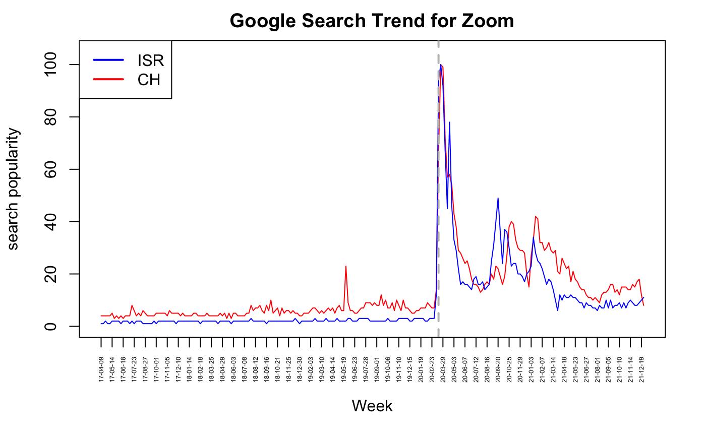
ITSA Zoom pre-processing
Should we apply log-transform?
heteroscedasticity
large absolute difference
Should we use Gaussian or Poisson distribution for error?
log-transformation(Introductory Econometrics, Wooldridge)
large enough quantity
Notes:
This is the time series for zoom data on Google Trend for Switzerland and Israel.
we use the log-transformation. Because the absolute difference between our data is very large. log-transformation can protect ordinary data from outliers.
Besides the variance is highly Heterogeneous before and after intervention, so log-transformation can stabilize the variance.
we use Gauss Distribution instead of Poisson Distribution, even though the data is actually counting data. We have 3 consideration:
First, the original number of counting is unavailable.
Second, we believe the counting number is large enough for similar analysis with Gauss.
Third, we have used log-transformation.

Slide 43
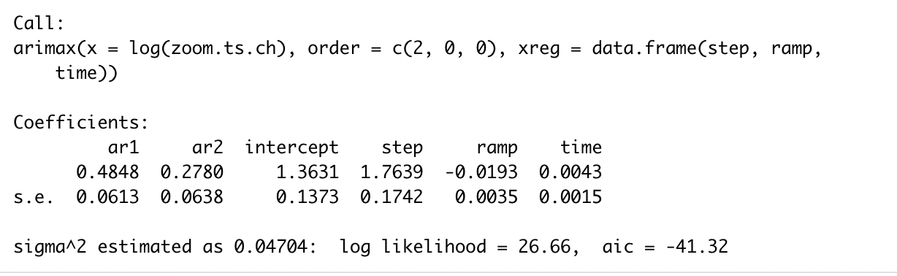
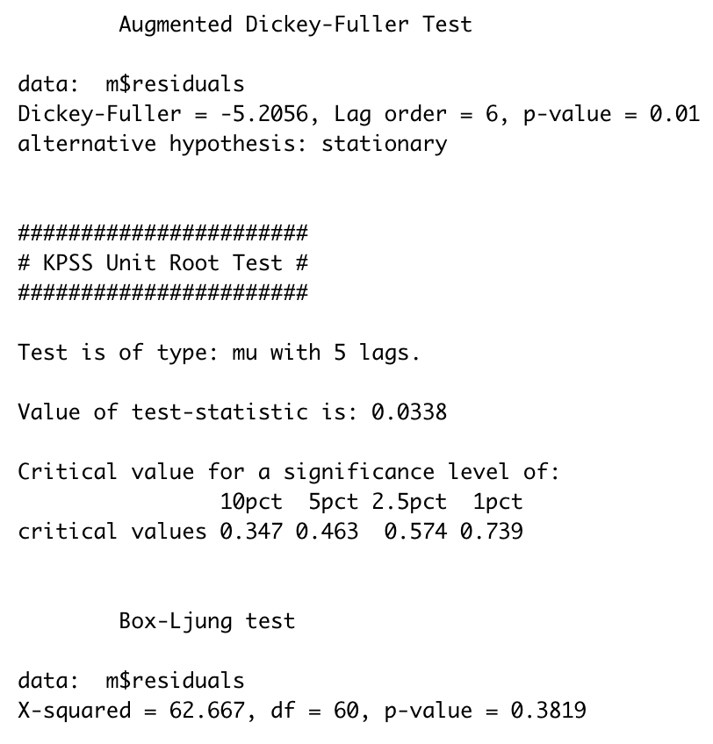
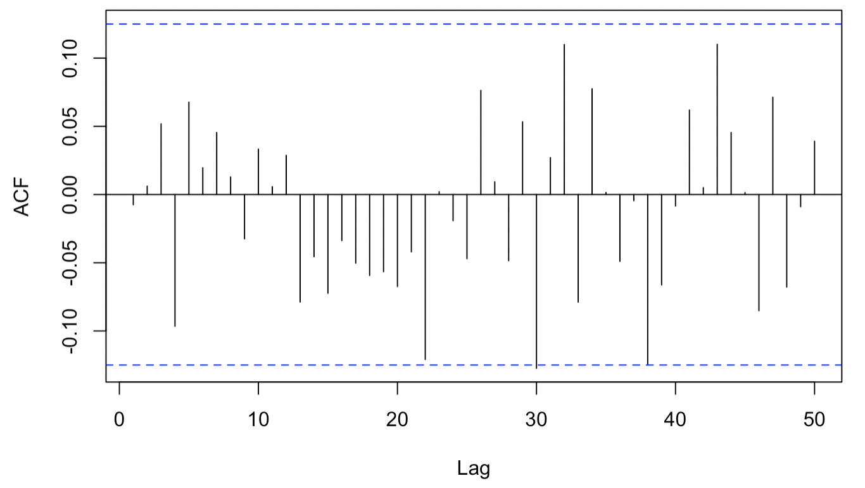
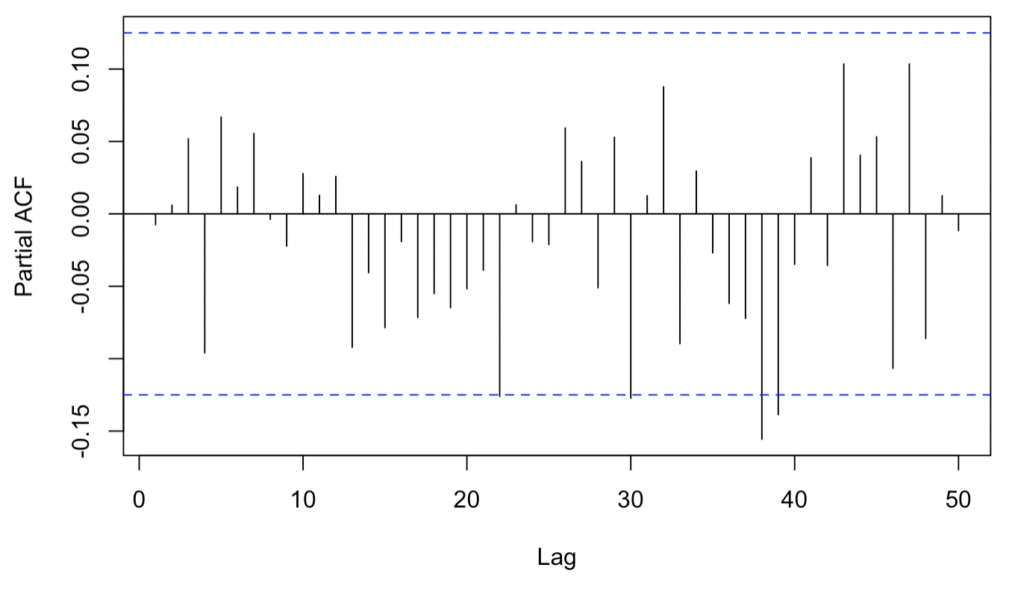
ITSA Zoom data analysis
model selection
Box test
AIC
parsimony
Notes:
This is our model fitting and model selection section. We select model based on AIC and parsimony. We accept the model when it can pass the Box test.
Here is our final model. The time series works well. all parameters are significant. The autocorrelation function is not unaccepble. The analysis of residence show it could be regarded as white noise. That is to say every assumption meets the data.
We have tried larger p and q. And more complex model here will not decrease AIC. The parameter will not be significant at all.
We also try removing the time term for eliminating long-term increasing trend, AIC will increase. Therefore the general trend for time is not neclectable, even for data before intervention.

Slide 44
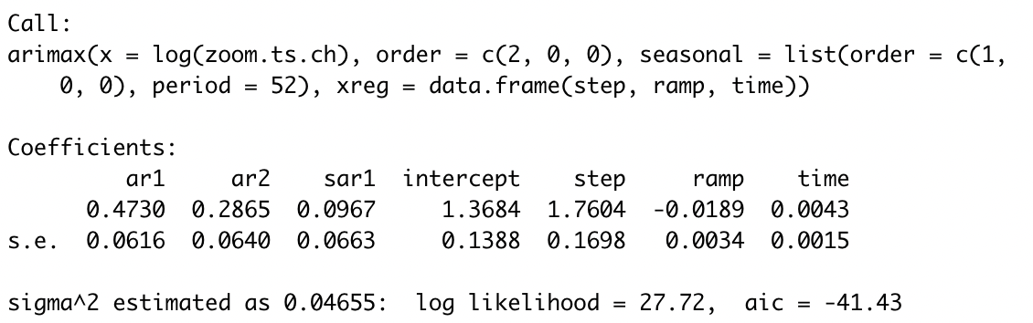
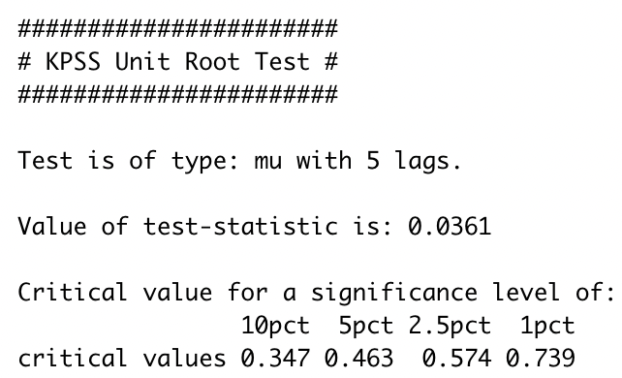
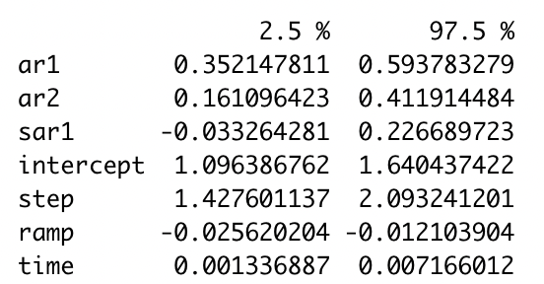
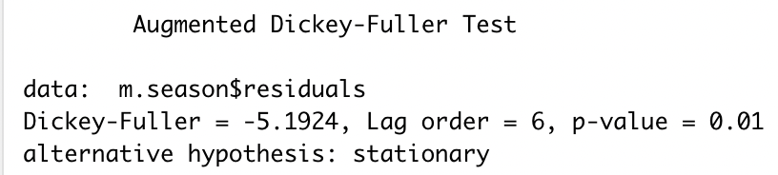
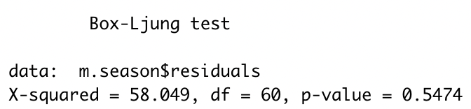
ITSA Zoom, Appendix seasonal model
Notes:
Here we also try the seasonal model.
The seasonality could decrease AIC slightly and the p-value for Box-Ljung test can also be slightly bigger.
We have more chance to admit the residuals are white noise.
Thus we could say considering the seasonal effect improve the model slightly.
Due to the parsimony, we regard it as a candidate model.
In our experience, there should be seasonality for our data.
Because, one heavy use of zoom is online course.As is known, there is no online course in summer and winter vacation.
Therefore there should be a seasonality.

Slide 45
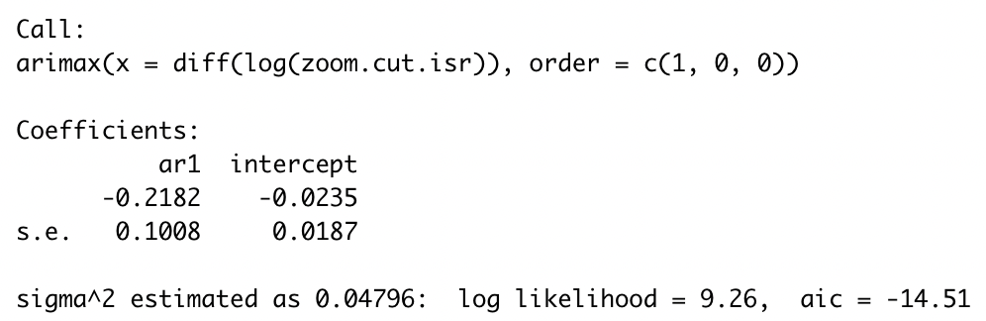
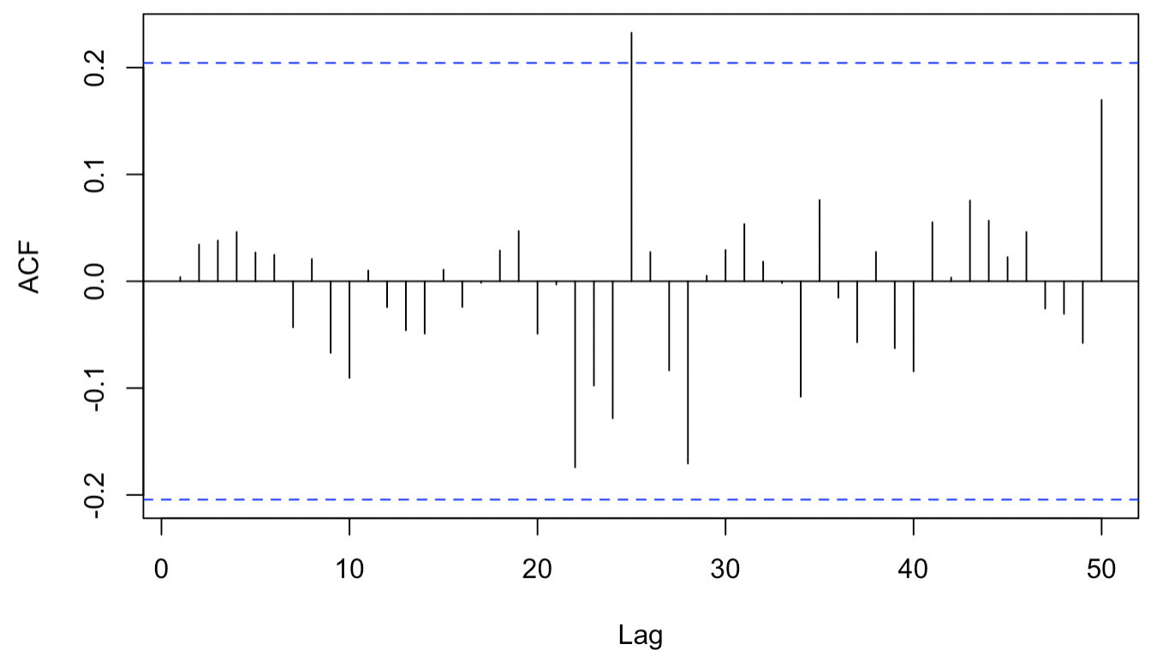
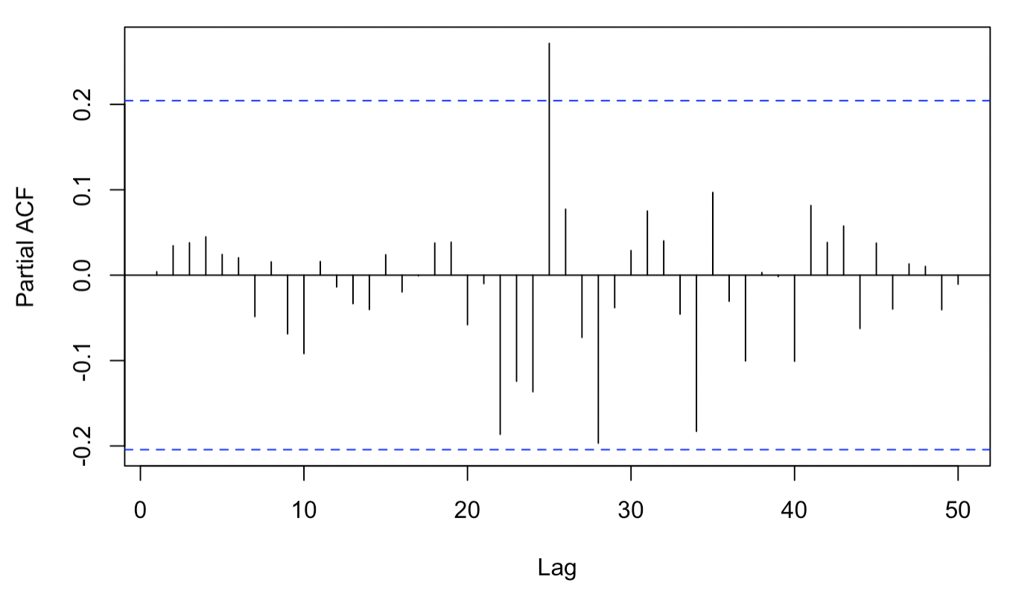
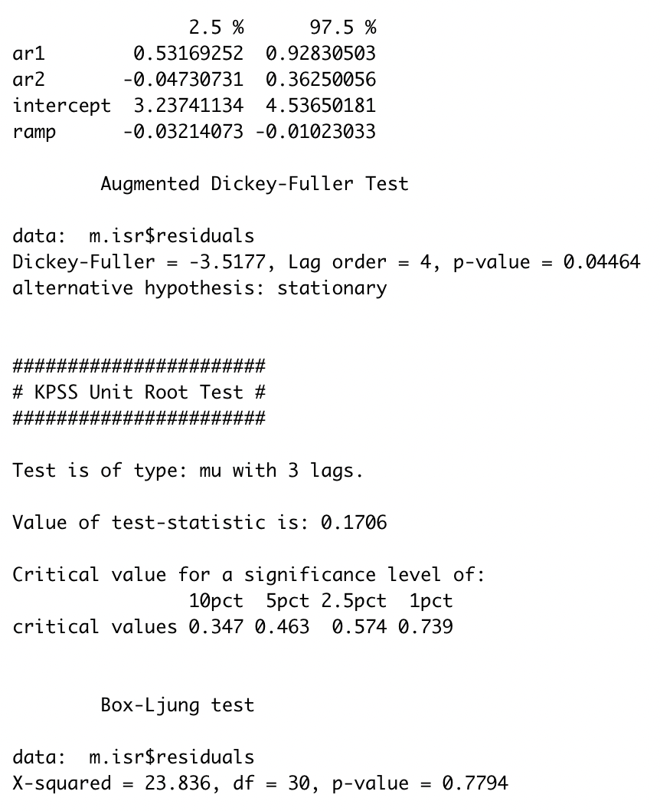
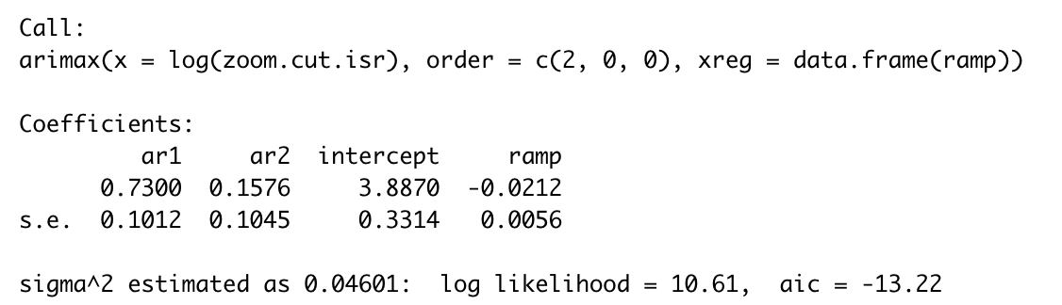



ITSA Zoom, Appendix Israel data
Start Date: 16.03.2020[p. 9]
Event Date: 16.03.2020[1,2]
End Date: same as Switzerland
[1] school closed(14.03.2020) https://academic.oup.com/cid/article/73/12/2265/6103916
[2] SAH(19.03.2020) https://www.reuters.com/article/us-health-coronavirus-israel-idUSKBN21622D
Notes:
It is about our ITSA on Israel data. We repeat the above process.
The school closed on March 14, 2020. The Stay at Home Policy Start from March 19, 2020. We could use March 16 at intervention date.
From the time pictures in page 9, we can know that the usage amount before intervention is too small to model.Therefore we only model the time series after intervention.
The final model for israel is presented. It has the same order with Switzerland and similar coefficients of the same magnitude.

Slide 46



ITSA Zoom dialectic analysis
Is indicator from Google Trend
really meaningful for
conclusion about utilization?
Google Trend:Zoom(worldwide)
[1]
[1] https://backlinko.com/zoom-users
[2] https://www.businessofapps.com/data/zoom-statistics/
[2]
Notes:
Is indicator from Google Trend really meaningful for conclusion about utilization?
To know this, we compare data from different sources. Notice the whole official data from zoom is not available. Or we will not use data on Google Trend.
Obviously, Search volume is neither proportional to daily users nor daily usage time. Our analysis does have some flaws
In fact, the number of daily participants & the meeting minutes are really meaningful anyway.
One explanation is that one central aim for search is to download. And if you have already had zoom on your computer, you will just click it instead of open chrome and counted by Google.

Slide 47
ITSA Zoom dialectic analysis
co-intervention
can be ignored
total population change
EG: Switzerland population + ~0.75% per year[1].
unstable policy & strain
EG: delta, omicron
Switzerland put in place stricter coronavirus measures(13.01.2021) [2]
Israel partly(03.05.2020), fully)(17.05.2020) open school[3]
festivals & holidays
EG: p9, Passover(April)
[1] https://www.worldometers.info/world-population/switzerland-population/
[2] https://www.thelocal.ch/20210113/explained-what-are-switzerlands-new-coronavirus-measures-jan-13/
[3] https://academic.oup.com/cid/article/73/12/2265/6103916
Notes:
There are also other issues we omit in our analysis process.
For example, the SAH policy is not stable at all. New strains came but we only consider the first outbreak.
Due to the changing circumstance, the SAH policy are implemented with different strength. We list some events about relaxing or strengthing restriction here.
Besides, festivals will definely cause a drop on time series that we could not explain in our model. The passover has an extremely obvious drop on the search volume for zoom. the season is easy. Who have meetings and take courses on holiday?

Slide 48



ITSA Appendix unemployment
Notes:
We also test the uunemployment data for the whole OECD. There are two candiatateb model.

Slide 49

ITSA Appendix unemployment
No data for Switzerland
unemployment start date https://www.timesofisrael.com/israels-unemployment-rate-back-to-pre-covid-level-of-4/
unpaid leave
https://www.hg.org/legal-articles/israel-imposing-unpaid-leave-on-employees-due-to-the-spread-of-coronavirus-updated-55052
Notes:
However, the pattern of Israel is quite different.
After survey, we find Israel have the unpaid leave policy.
Therefore many people choose unpaid leave and they are not counted by OECD.
This example shows that how important it is to have a concrete understanding of the policy.

Slide 50

Conclusion

Slide 51


Conclusion - Quantitative
Statistical method suited for predicting pandemic peaks
Limitation: rebounds, might not be suitable to predict long-term developments
Policy measures can be compared with that (contact parameter)
Might need mix of methods to reliably predict pandemic developments (more flexibility)
Logistic+Prophet Model: detects size, trend and able to predict turning-points
Modelled on logistic curve -> assumes maximum of outbreak/ small peaks are neglected
ARIMA-Models: detects trends very well
Primarily suited for linear analysis -> Does that hold for a pandemic?
Use of zoom can be modelled well, with a step to a high level, which then gradually decays.
SAH has a direct effect on zoom use.
The use of zoom for this week is influenced by the last 2 weeks.
For Swiss & ISR, the parameters for AR1, AR2, ramp is very close.
Parameters might be meaningful more generally.
SEIR
ML + Stats
Approach
Interrupted
Time Series

Slide 52
Conclusion – Social Analysis
Case numbers
Exploratory Analysis
In terms of actual case numbers: follows roughly same path for both countries
Switzerland with less absolute case numbers, but with a rebound
We can see an abrupt change in behavior due to SAH policy​ Crucial: Find right proxy for target (Google Zoom trend vs actual usage)
Switzerland/Israel pretty similar in terms of change
Working behavior

Slide 53

Transform data results into knowledge
How can results of the data analysis be generalised to create new knowledge —
to forecast, or to interfere with — the system that produced the data?
Emergence of new life habits and widely used services
(e.g. explosion of zoom utilisation), creates the need for new regulations.
Crisis disturbs societal organization, creates and accentuates inequalities.
These inequalities can be identified with correlated data.
Circle out differences between political/societal systems (Switzerland – Israel).
Learn from the past. Data results help to assess policy measures,
which can then be improved for the future.
Not only the crisis (e.g. covid case) needs to be observed, but also other trends (e.g. unemployment) to ensure social welfare.
→ Interesting would be to develop models that include pandemic as well as societal data in order to improve general decision-making monitoring.

Slide 54

Being careful with data and conclusions
Covid cases are only the tip of the iceberg.
Case numbers can be the reason for societal developments,
but can also be due to societal developments.
One needs to interfere
more closely with the underlying layers
(how did working behaviour changed, unemployment)
to fully understand pandemic situations.

Slide 55
ANNEX - Israel
Isolation:
For everyone having more than 38 fever
If close contact with familiy members
…
5 days for foreigner crossing the border (except if recovered in the last 60days)
→ Much stricter measures than in Switzerland.
Source: corona.health.gov.il

Slide 56
Future Works
Model part:
Compare results of more countries in same period to test our parameters
Find reliable data sources of active cases
Modify the model based on social impact (policy, public opinion)
Analysis part:
Incorporate a more refined understanding of a series of policy implementation rather than focusing on a major policy.
Find examples about COVID beyond policy analysis that can apply ITSA.
Explore the impact of COVID on other aspects of society, such as psychology.
Find suitable examples of applying transfer entropy and causality between COVID and social indicator.

Slide 57

Thank you for watching

Slide 58
References
[1]Bernal, J. L., Cummins, S., & Gasparrini, A. (2017). Interrupted time series regression for the evaluation of public health interventions: a tutorial. International journal of epidemiology, 46(1), 348-355.
[2] Schaffer, A. L., Dobbins, T. A., & Pearson, S. A. (2021). Interrupted time series analysis using autoregressive integrated moving average (ARIMA) models: a guide for evaluating large-scale health interventions. BMC medical research methodology, 21(1), 1-12.
[3] Gilmour, S., Degenhardt, L., Hall, W., & Day, C. (2006). Using intervention time series analyses to assess the effects of imperfectly identifiable natural events: a general method and example. BMC medical research methodology, 6(1), 1-9.
[4] Carter, T. M., & Turner, N. D. (2021). Examining the immediate effects of COVID-19 on residential and commercial burglaries in Michigan: An interrupted time-series analysis. Journal of Criminal Justice, 76, 101834.
[5] Morishita, T., Takada, D., Shin, J. H., Higuchi, T., Kunisawa, S., Fushimi, K., & Imanaka, Y. (2022). Effects of the COVID‐19 pandemic on heart failure hospitalizations in Japan: interrupted time series analysis. ESC heart failure, 9(1), 31-38.
[6] Pirkis, J., John, A., Shin, S., DelPozo-Banos, M., Arya, V., Analuisa-Aguilar, P., ... & Spittal, M. J. (2021). Suicide trends in the early months of the COVID-19 pandemic: an interrupted time-series analysis of preliminary data from 21 countries. The Lancet Psychiatry, 8(7), 579-588.
[7] Koppel, S., Capellan, J. A., & Sharp, J. (2022). Disentangling the Impact of Covid-19: An Interrupted Time Series Analysis of Crime in New York City. American Journal of Criminal Justice, 1-27.
[8] Lane, T. J., Gray, S., Hassani-Mahmooei, B., & Collie, A. (2018). Effectiveness of employer financial incentives in reducing time to report worker injury: an interrupted time series study of two Australian workers’ compensation jurisdictions. BMC public health, 18(1), 1-10.
[9] Sun, P., Chang, J., Zhang, J., & Kahler, K. H. (2012). Evolutionary cost analysis of valsartan initiation among patients with hypertension: a time series approach. Journal of Medical Economics, 15(1), 8-18.
[10] Lopez Bernal, J. A., Gasparrini, A., Artundo, C. M., & McKee, M. (2013). The effect of the late 2000s financial crisis on suicides in Spain: an interrupted time-series analysis. The European Journal of Public Health, 23(5), 732-736.

Slide 59
References
[11] Alzahrani, S. I., Aljamaan, I. A., & Al-Fakih, E. A. (2020). Forecasting the spread of the COVID-19 pandemic in Saudi Arabia using ARIMA prediction model under current public health interventions. Journal of infection and public health, 13(7), 914–919. https://doi.org/10.1016/j.jiph.2020.06.001
[12] Singh R, Rani M, Bhagavathula A, Sah R, Rodriguez-Morales A, Kalita H, Nanda C, Sharma S, Sharma Y, Rabaan A, Rahmani J, Kumar P Prediction of the COVID-19 Pandemic for the Top 15 Affected Countries: Advanced Autoregressive Integrated Moving Average (ARIMA) Model JMIR Public Health Surveill 2020;6(2):e19115 URL: https://publichealth.jmir.org/2020/2/e19115
[13] https://www.swissinfo.ch/eng/first-suspected-case-of-omicron-variant-detected-in-switzerland/47149218
[14] Forecasting the dynamics of COVID-19 Pandemic in Top 15 countries in April 2020: ARIMA Model with Machine Learning Approah,Pavan Kumar, Himangshu Kalita, Shashikanta Patairiya,eYagya Datt Sharma, Chintan Nanda, Meenu Rani, Jamal Rahmani, Akshaya Srikanth Bhagavathula doi:https://doi.org/10.1101/2020.03.30.200462274.
[15] Yang, Z., Zeng, Z., Wang, K., Wong, S. S., Liang, W., Zanin, M., ... & He, J. (2020). Modified SEIR and AI prediction of the epidemics trend of COVID-19 in China under public health interventions. Journal of thoracic disease, 12(3), 165.
[16] Centers for Disease Control and Prevention. CDC Updates and Shortens Recommended Isolation and Quarantine Period for General Population, 2021, https://www.cdc.gov/media/releases/2021/s1227-isolation-quarantine-guidance.html. Accessed 23 Apr. 2022.
[17] Catherine Schuster Bruce . Here's how long people with COVID-19 might remain contagious, according to the best available data, 2022, https://www.businessinsider.com/covid-how-long-contagious-infectious-period-omicron-delta-rapid-test-2022-1?r=US&IR=T. Accessed 24 Apr. 2022.
[18] Irons, N. J., & Raftery, A. E. (2021). Estimating SARS-CoV-2 infections from deaths, confirmed cases, tests, and random surveys. Proceedings of the National Academy of Sciences, 118(31).

Slide 60
References
[19] P. Wang & cie, Prediction of epidemic trends in COVID-19 with logistic model machine learning technics, Chaos, Solitons and Fractals, Elsevier, 2021.
[20] M. Zivkovic & Cie, COVID-19 cases prediction by using hybrid machine learning and beetle antennae search approach, Sustainable Cities and Society, Elsevier, 2021.
[21] J. C. Clement & Cie, A survey on mathematical, machine learning and deep learning models for COVID-19 transmission and diagnosis, IEEE Reviews in biomedical engeneering, EMB, 2022.
[22] W.-X. Tang & Cie, Causal Analysis of impact factors of COVID-19 in China, Elsevier 2022.
[23] F. Rustam & Cie, COVID-19 future forecasting using supervised machine learning models, IEEE Access, 2020.
[24] S. Khalilpourazari, & Cie, Designing a hybrid reinforcement learning based algorithm with application in prediction on the COVID-1 pandemic in Quebec, Annals of operations research, Springer, 2020.
[25] Z. Yang & Cie, Modified SEIR and AI prediction of COVID-19 in China under public health interventions, Journal of thoracic disease.
[26] Z.-K. Zhang, Dynamics of information diffusion and its applications on complex networks, Physics reports, Elsevier, 2016.
[27] Singh R, & Cie, Prediction of the COVID-19 Pandemic for the Top 15 Affected Countries: Advanced Autoregressive Integrated Moving Average (ARIMA) Model, JMIR Public Health Surveill 2020
[28] Saleh I. Alzahrani, & Cie, Forecasting the spread of the COVID-19 pandemic in Saudi Arabia using ARIMA prediction model under current public health interventions.
[29] Jiang Li. Using media data to infer the spread of the new coronavirus[R/OL].(2020-04-02)[2022-05-12]

